Slide 1
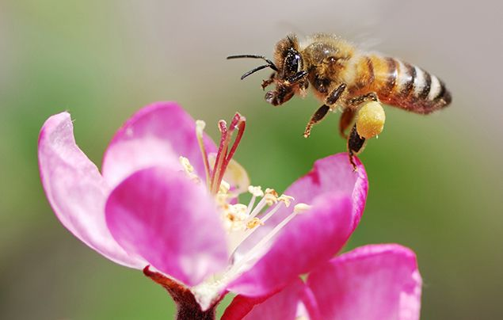
What’s All The Buzz About Honey Bees?

Slide 2
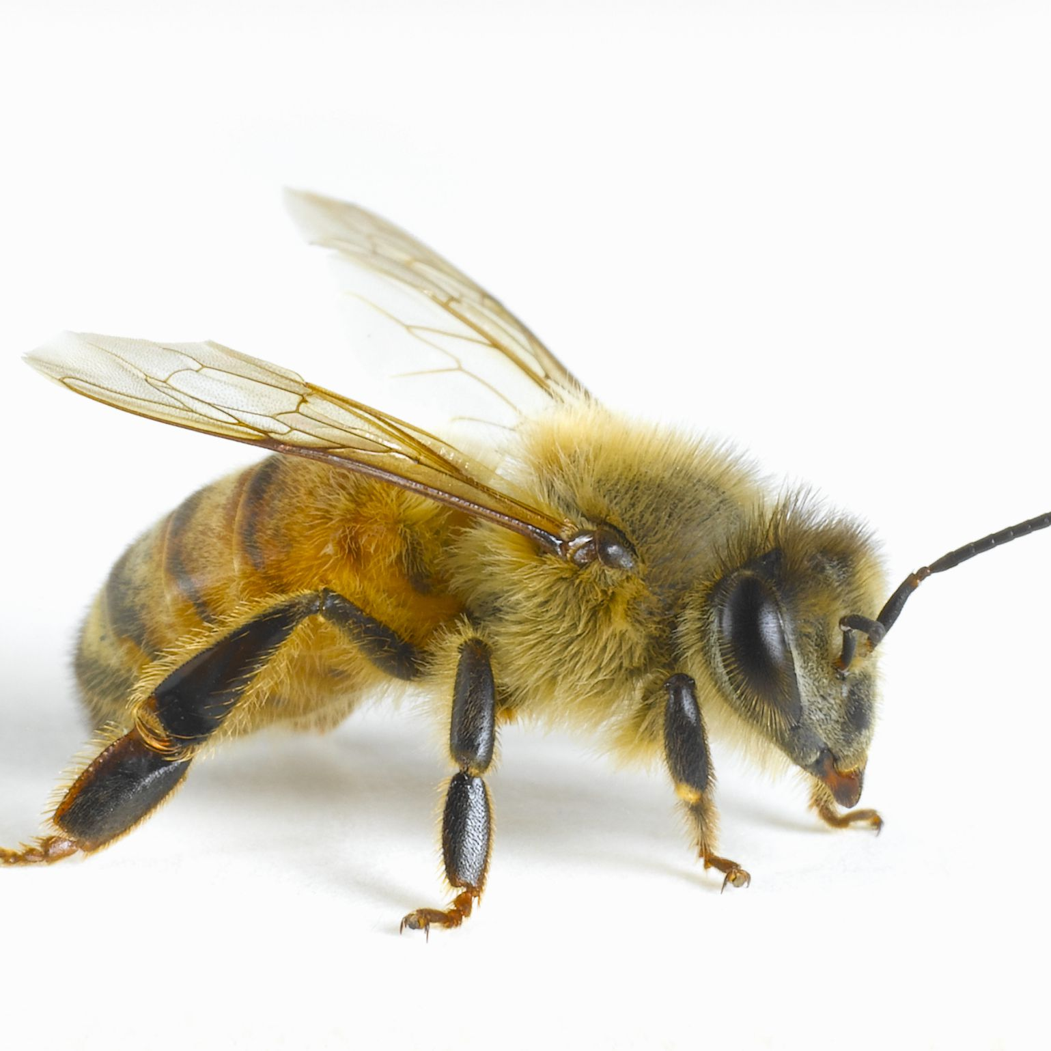
Apis Mellifera
The Apis Mellifera most commonly known as the “honey bee” is a eusocial flying insect within the genus apis of the bee clade.
The honey bee which isn’t a native to North America can be found in Europe, Africa, Western & Central Asia.

Slide 3
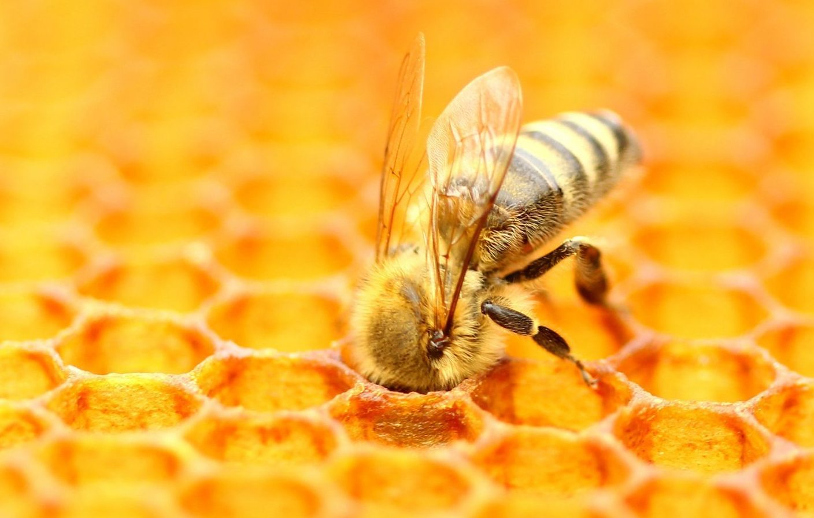
Classification
Kingdom: animal
Phylum: arthropoda
Class: insecta
Order: hymenoptera
Family: apidae
Genus: apis
Species: mellifera

Slide 4
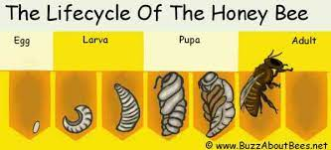
Life Cycle
4 Stages of the Honey bee
EGG - an egg the size of about a grain of rice gets laid by the queen bee. (queen may lay 2000-3000 per day)
LARVA - after 3 days, the egg evolves into a larva. At this point it is blind and has no legs still.
PUPA - the larva pupates and develops into something more recognizable. The head, legs, thorax, abdomen and wings are all intact.
ADULT - finally, a young adult bee emerges from the egg cell by chewing the wax cap.

Slide 5
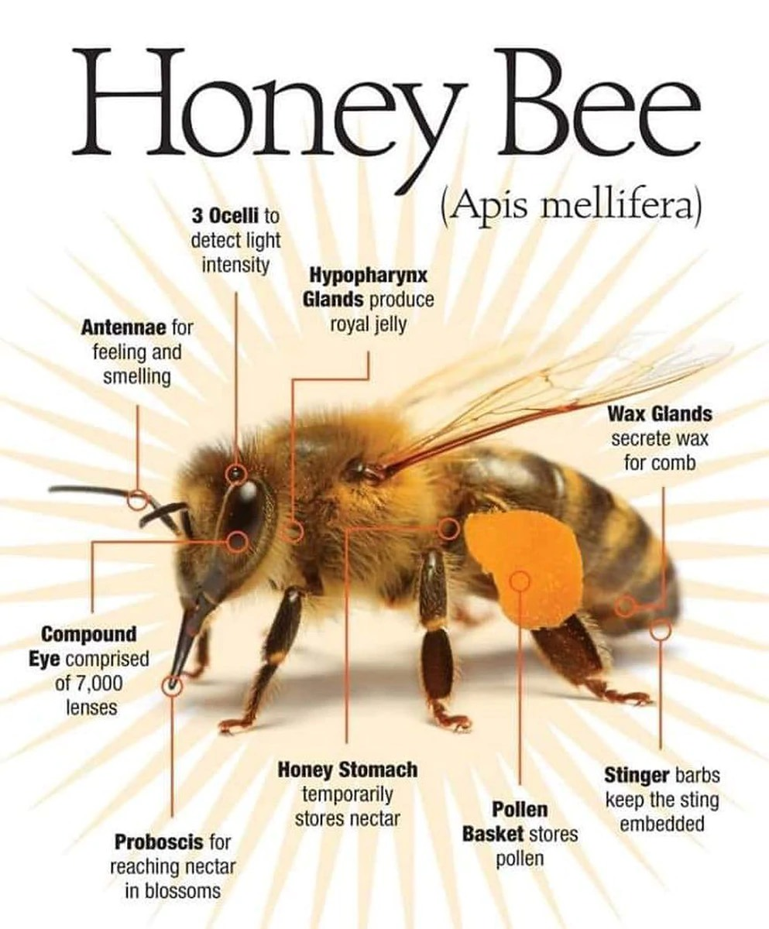
Anatomy
Antenna for feeling and smelling
Ocelli to help them navigate back to their hives
Yellow fur around their body to help attract pollen
Wax glands to secrete wax on the honey comb
Pollen basket on the hind leg to help store pollen
https://galenafarms.com/blogs/articles/the-honey-bee-monarchy

Slide 6
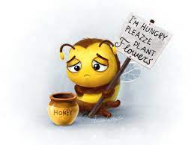
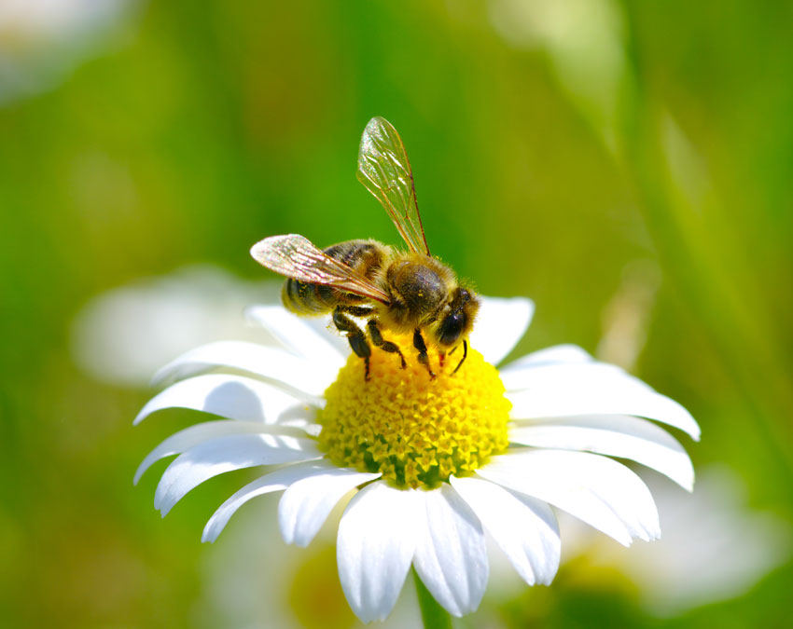
Diet
Honey bees diet consists of feeding on nectar and the pollen from flowers (dandelions, milkweed, clover, and a variety of fruit trees).
Pollen one of the most nutritious natural foods contains all the requirements for a honey bee. (sugars, carbohydrates, enzymes, proteins, vitamins and minerals).
The larvae and the future queen bee gets fed royal jelly first, and pollen afterwards from the worker bees. (royal jelly is even more nutritious and beneficial than pollen).

Slide 7
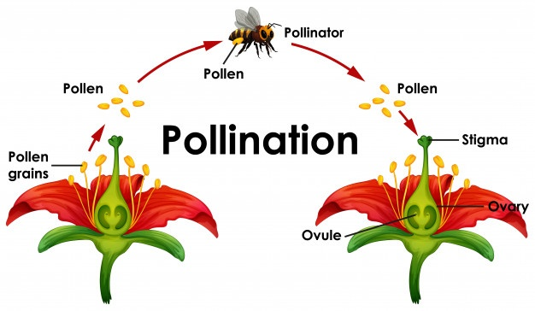
The Procezz via Pollination
Transfer of pollen from one flower to another is what’s known as pollination, which in conclusion is the reproduction of plants.
Honey bees fly from flower to flower collecting pollen (which has the male gametes) and dropping them off to other plants directly on the stigma (female reproduction) of other plants.
Fertilization occurs once the stigma receives pollen from the honey bee.

Slide 8
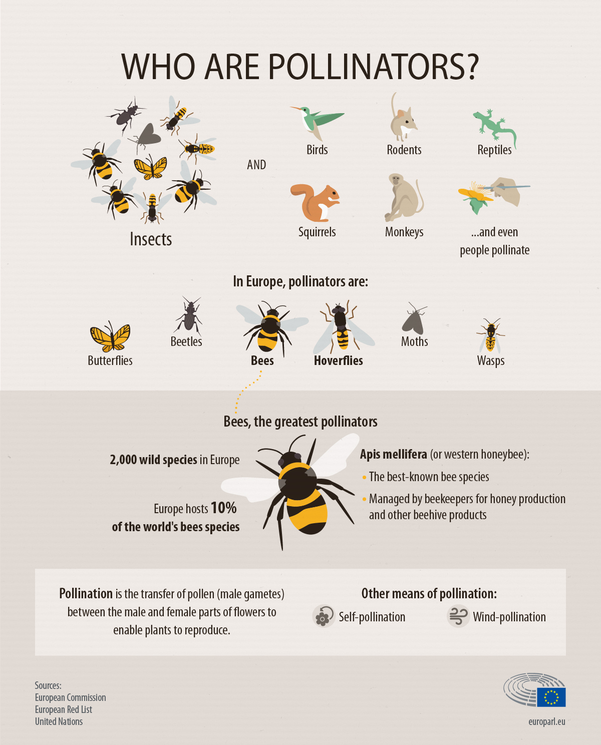
The
Greatest
Pollinators
Honeybees are 2nd to none when it comes to pollination in the entire world.
Bee pollen relieves inflammation
Strengthens the immune system and reduces stress
Is a great antioxidant
Boosts liver health
https://www.europarl.europa.eu/news/en/headlines/society/20191129STO67758/what-s-behind-the-decline-in-bees-and-other-pollinators-infographic

Slide 9
Some Sweet products
Royal jelly
Pollen
Honey (The only insect produced food for humans)
Wax
Propolis

Slide 10
What’s the Buzz?
1 in 3 foods we take a bite of are because of pollination from bees
85% of plants and trees survival relies on pollinators from bees
30% of the entire worlds crops survival depend and rely on bees
70 of the top 100 food crops are pollinated by bees

Slide 11
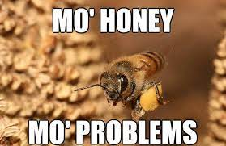
What’s the problem?
The biggest problems and the majority of death causation for the honey bees are ?
pesticides
pathogens/parasites
habitat loss
invasive species
climate change
genetic diversity

Slide 12
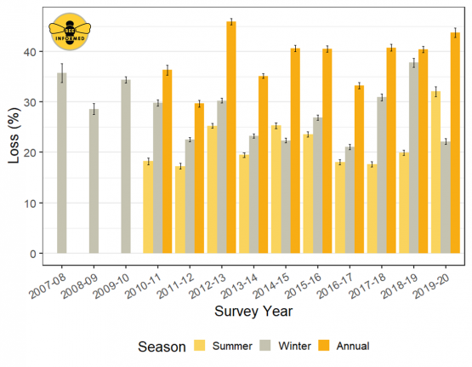
Buzzkill.
https://phillybeekeepers.org/bip-releases-colony-loss-data-for-2019-2020/
From April 1st 2019 to 2020 about 44% of colonies were lost.
Losses during the 2019 summer was the highest ever recorded to date.
The decline in honey bees are getting worse and worse each year 30% annual decline based on commercial beekeepers.

Slide 13
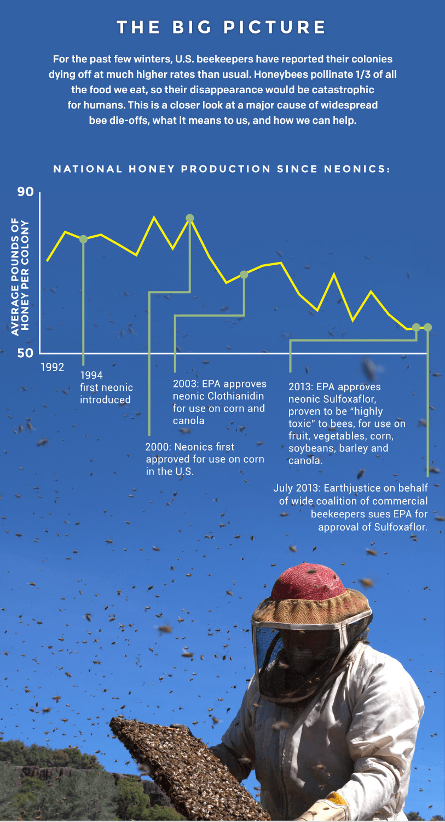
Pesticides
The Biggest causation of death in honeybees
Neonicotinoids better known as “neonics,” are pesticides that are used in more than 120 crops. From fruits, corn, canola, vegetables and grains to get rid of and kill insects.
Neonics continue to thrive inside of a plant forever from the seconds it’s been applied.
Once a honeybee lands on a plant to gather pollen, the honeybees body gets exposed and gathers the toxic chemicals (sulfoxaflor) from the neonics.
Neonics cause honeybees illness and death by making them susceptible to diseases and mites by weakening their immune system.
Entire colonies can get contaminated if a bee passes on contaminated pollen off to another bee.
Neonics toxins are powerful and can affect bees sensory neuron receptors causing them not to be able to navigate back to the bee hive and eventually causing death.
https://earthjustice.org/features/infographic-bees-toxic-problem

Slide 14
How can YOU help?
Building a garden filled with flowers containing pollen to help with more food sources for honeybees.
Be VERY cautious in using pesticides, reduce the usage of pesticides or switch to more organic herbicides.
Support beekeepers in your area, helping by purchasing products from them or donating to help their organization.
Don’t kill bees!!

Slide 15
“If the bee disappears from the surface of the earth, man would have no more than four years left to live.”
-Albert Einstein

Slide 16
SOURCES
https://www.natgeokids.com/uk/discover/animals/insects/honey-bees/
https://www.thoughtco.com/honey-bee-apis-mellifera-1968092
https://www.omlet.co.uk/guide/bees/about_bees/history/
https://galenafarms.com/blogs/articles/the-honey-bee-monarchy
https://www.aces.edu/blog/topics/bees-pollinators/nectar-and-pollen-producing-plants-of-alabama-a-guide-for-beekeepers/
https://www.orkin.com/pests/stinging-pests/bees/honey-bees/what-do-honey-bees-eat
https://dribbble.com/tags/hungry_bee
https://www.ypsilibrary.org/2020/06/bees/
https://m.facebook.com/JustBeeFriendly/photos/why-bees-are-so-important-give-us-a-in-the-comments-if-you-care-about-beespollin/1126038690864825/
https://phillybeekeepers.org/bip-releases-colony-loss-data-for-2019-2020/
https://knowyourmeme.com/photos/342475-bees
https://www.museumoftheearth.org/bees/threats
https://earthjustice.org/features/infographic-bees-toxic-problem
https://www.healthline.com/health/bee-pollen-benefits%23research-says4

