Slide 1
Effects of Huntington's Disease

Slide 2
What is Huntington’s Disease
It is the degeneration of the brain's nerve cells that occurs as a result of a hereditary disorder. For most people, it begins in their 30s or 40s. Movement, cognition, and psychological symptoms are often seen as Huntington's disease progresses.

Slide 3
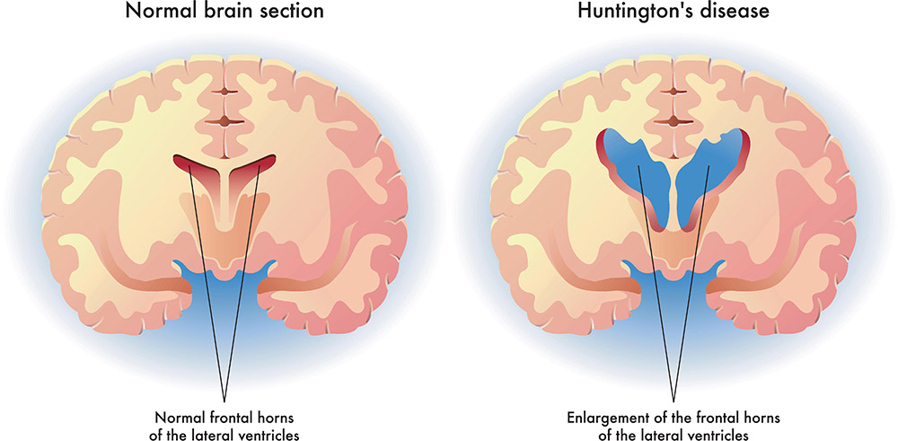
As you can see the brain with Huntington’s disease is missing a good amount of brain matter. This includes brain cells. The brain slowly degrades and shrinks in size overtime
source:https://www.healthdirect.gov.au/huntingtons-disease

Slide 4
Symptoms
There are many symptoms for Huntington’s Disease:abnormal walking, increased muscle activity, involuntary movements, problems with coordination, loss of muscle, or muscle spasms, amnesia, delusion, lack of concentration, mental confusion, slowness in activity, or difficulty thinking and understanding, compulsive behavior, fidgeting, irritability, or lack of restraint, delirium, depression, hallucination, or paranoia, anxiety, apathy, or mood swings, difficulty speaking, memory loss, tremor, and weight loss are among the many more symptoms that come with this disease.
Source:https://hamiltongrovehealth.blog/huntingtons-disease-heredity-dementia
.

Slide 5
Disease Statistics
As a result, Huntington's is a hereditary illness. It is handed on from generation to generation by parents. A kid has a 50% chance of inheriting their parent's Huntington's illness. Having a kid who does not have the condition does not mean that he or she will pass it on to future generations. Some patients with Huntington's disease have no known family history of the condition.
Source:https://www.hopkinsmedicine.org/health/conditions-and-diseases/huntingtons-disease

Slide 6
Rate of Occurrence
Huntington's disease affects an estimated one in every 10,000 people worldwide, or around 30,000 people in the United States. One in every sixteen incidences of Huntington's disease in children is a juvenile case. No one demographic is at risk for Huntington's disease. It affects people of all colors and ethnicities, as well as men and women alike.

Slide 7
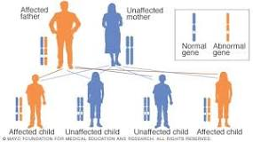
Treatments
Sadly as of right now no cure for this disease exists. That doesn’t mean there are no ways to alleviate the pain or to make it more bearable. People who exhibit certain symptoms may get advantages from medical treatment, including both physical and mental health care.
An hereditary flaw in a single gene is what brings on the symptoms of Huntington's disease. Because Huntington's disease is an autosomal dominant illness, it only takes one faulty gene copy for a person to be at risk for developing the condition. A individual receives two copies of every gene, with the exception of those genes that are located on the sex chromosomes; one copy comes from each of their parents. A parent who has a mutated gene has the potential to give their child either the unhealthy or the healthy copy of the gene. Because of this, there is a fifty percent probability that the gene that is responsible for the genetic illness will be passed on from parent to kid in the family.
Source:https://www.mayoclinic.org/diseases-conditions/huntingtons-disease/symptoms-causes/syc-20356117

