Slide 1
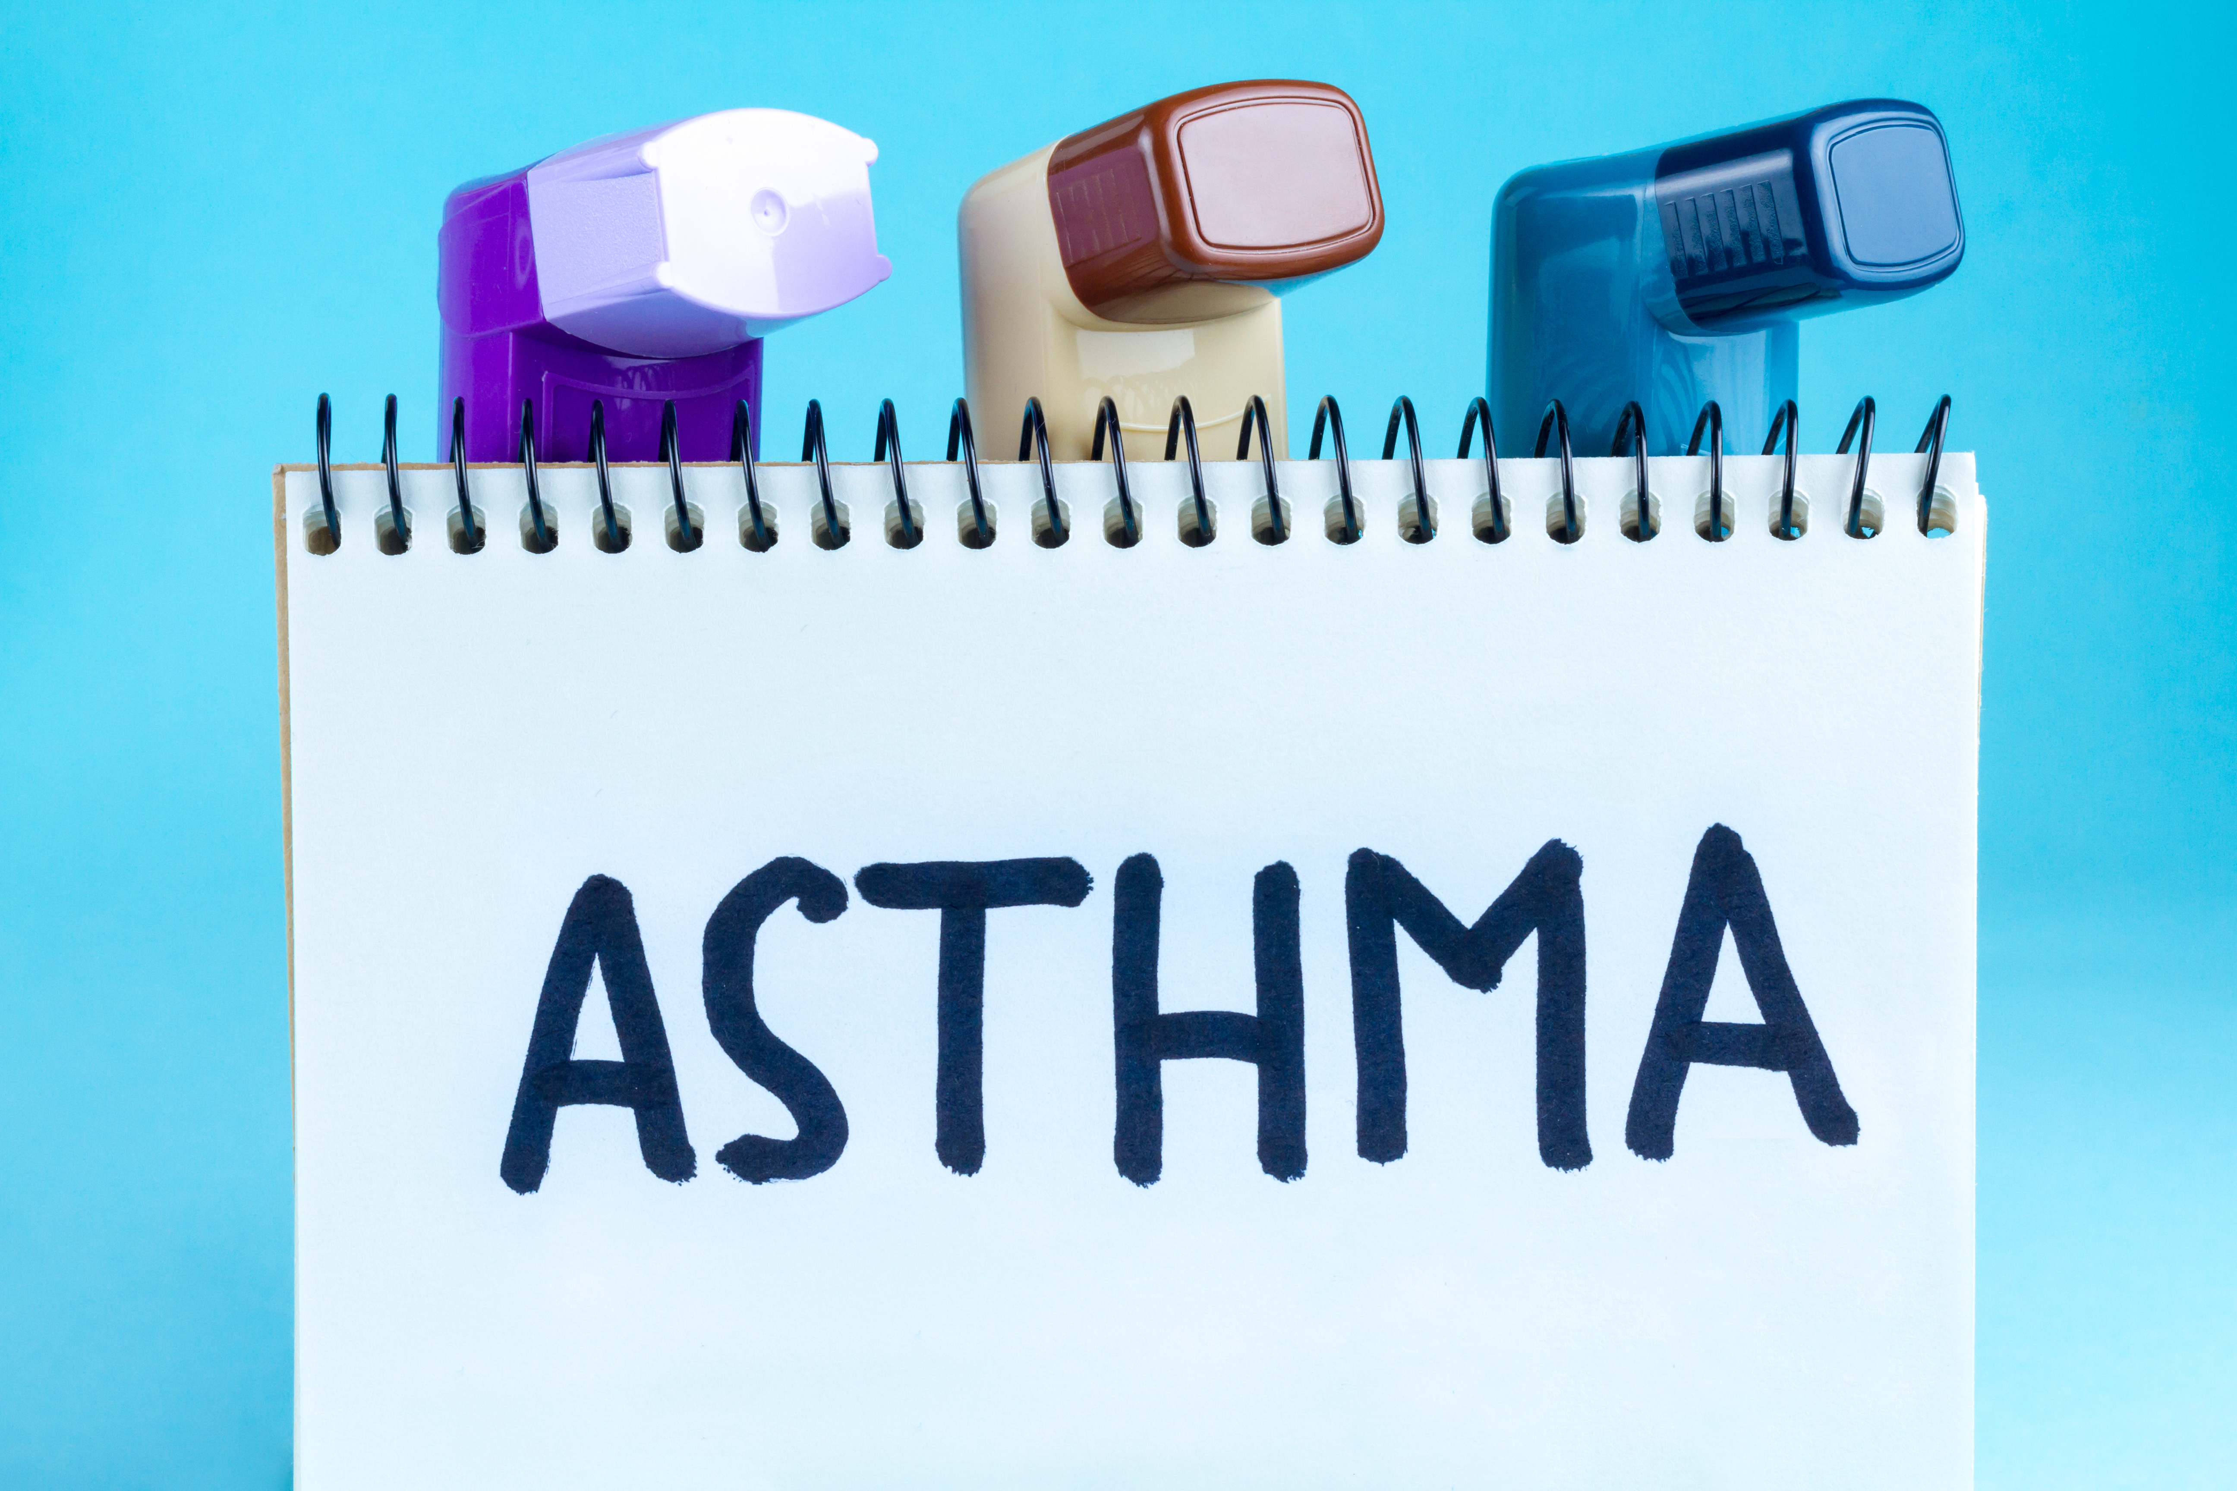

Slide 2
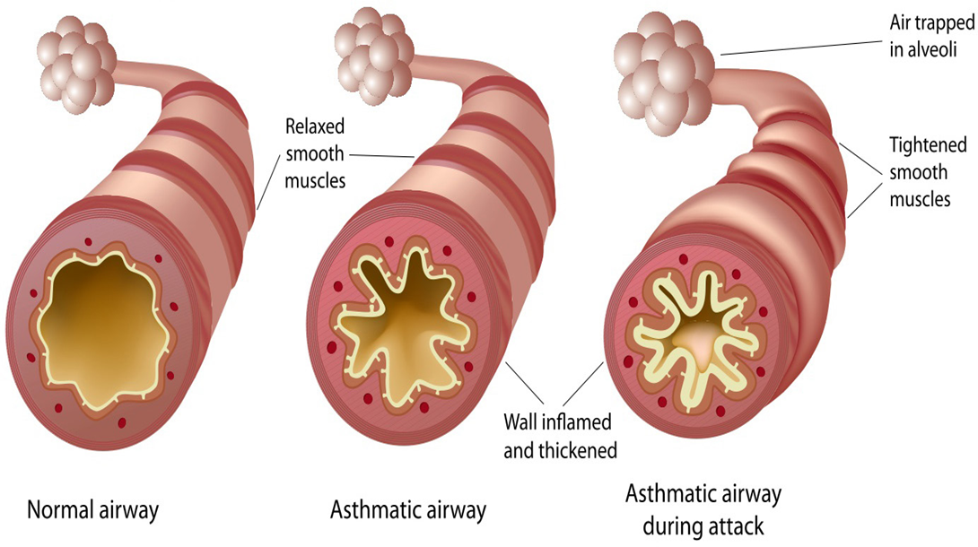
What is asthma?
Asthma is a condition that causes the airways to become narrow; due to
Increase in mucus production
Inflammation or swelling
Shrinkage of muscles around the airways

Slide 3
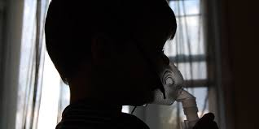
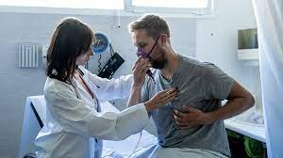
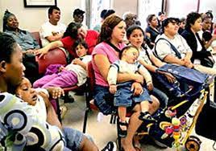
Introduction
Asthma remains a significant public health problem. In 2014, about 9% of children and 7.5% of adults reported to a physician diagnosis of current asthma.
The role of perceived discrimination in asthma status and outcomes are aged 8–21 years of age
This prevalence has been reported to be as high as 20–30% in some underrepresented minority communities

Slide 4
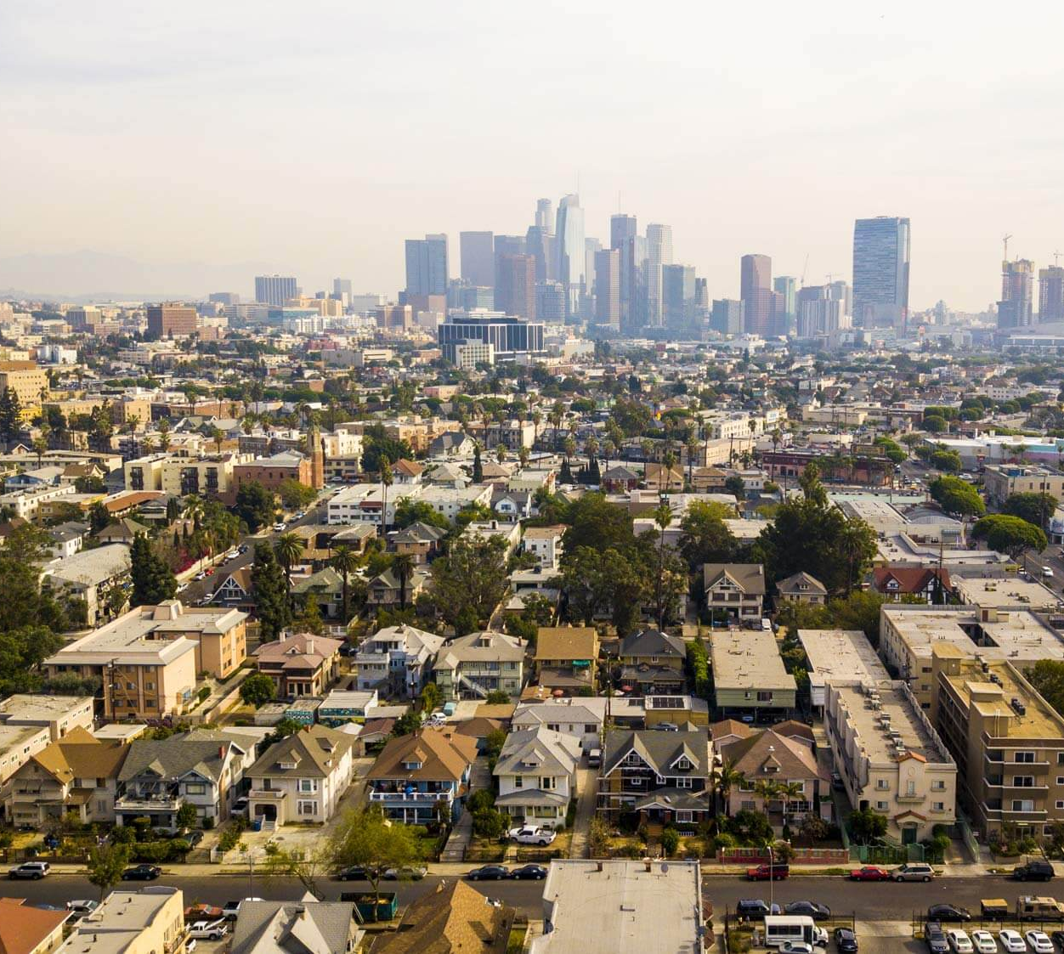
Who and Where Is the Disadvantaged?
According to National Health Interview Survey data from 2009 to 2011 found that independent risk factors for asthma were Black race, Puerto Rican ethnicity, and low household income—not residence in poor or urban areas.

Slide 5
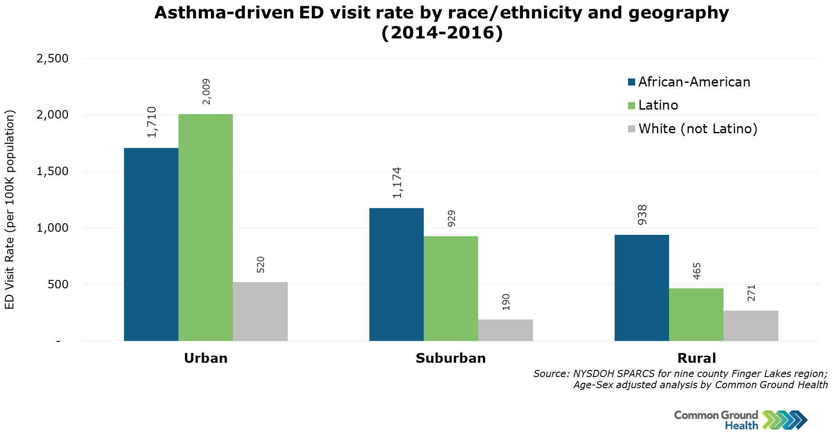
American Community Survey includes poverty rates, housing value, and homeownership. Each ZIP code is assigned a socioeconomic (SES) index ranking from 1 to 5.

Slide 6
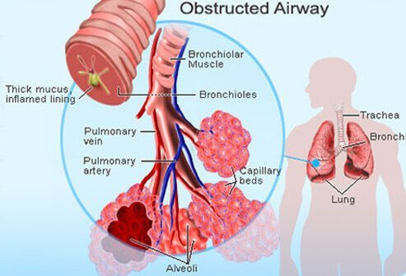
Physiological effects of Asthma
Inflammation ​of the air passages results in an abnormal immune response.
These actions lead to wheezing, coughing, chest tightness, and shortness of breath experienced during an asthma attack
https://youtu.be/Yp5ixuFiMmM

Slide 7
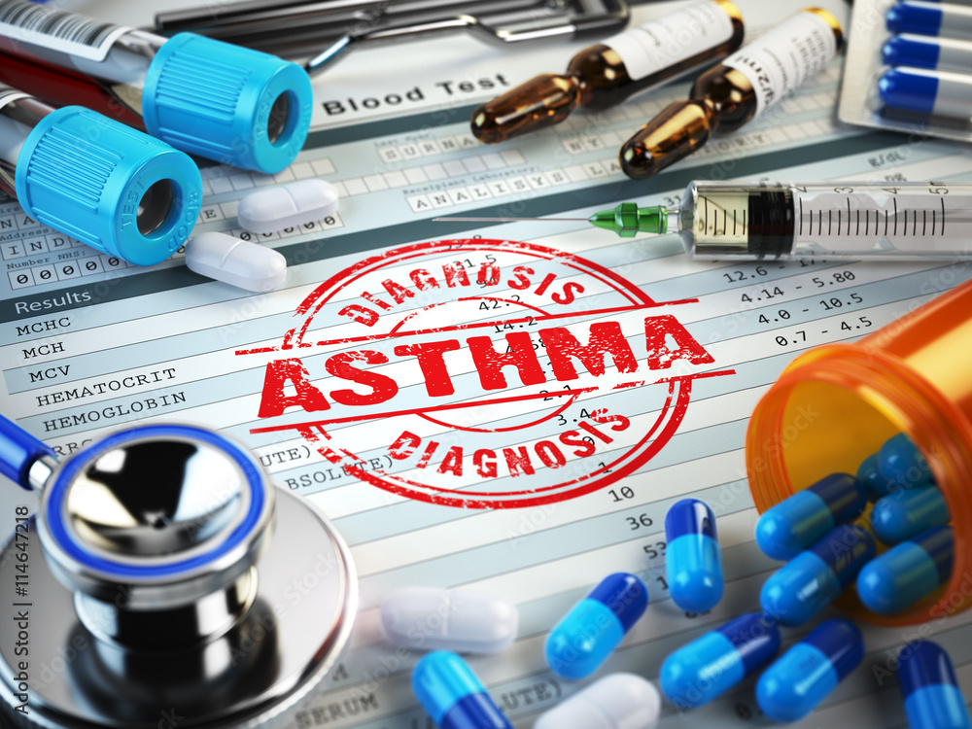

Slide 8
Medical History
Physical Exam
Lung and breathing test

Slide 9
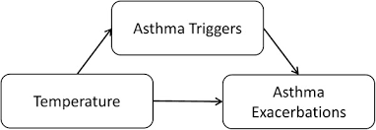
Mechanisms Used
Observational studies:
Examination of the physical environment and social context contribution to asthma morbidity has been quite revealing.
Acyclic graphing:
Allows one to examine multiple variables’ effect on an outcome in one model

Slide 10
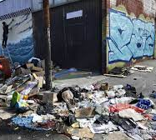
Outcome of the Disadvantage
After observing asthma in the disadvantaged populations, the challenges lead to socioeconomic factors and poor environmental such as;
Allergen/pollutant exposures
Psychosocial stressors
Smoking and secondhand smoke
Poor medication adherence
Lack of access to medicines

Slide 11
Asthma Signs and Symptoms
Coughing
Wheezing
Chest tightness
Shortness of breath
Excessive fatigue

Slide 12
Asthma triggers:
Pollen
Mold
Dust
Weather changes
Animal’s dander and
cockroach droppings
Second-hand smoke

Slide 13
How to treat asthma?
Long -Term Control
Quick- Relief Medicines
Known as controllers
Prevents lung inflammation, but will not help during an asthma attack
Should be taken for several days before positive effects
Known as recuse medicines
Immediate relief and last long
Treats asthma attacks

Slide 14
Future Directions and Recommendations
Asthma continues to be a significant cause of morbidity and mortality in low-income communities.
However, recent research has shown great promise of improved outcomes when tailored, multifaceted approaches.

Slide 15
Conclusions in the Disadvantaged Communities
Analyzed in the 2011 American Housing Survey and found that poor housing quality was associated with asthma diagnosis and emergency department visits.
Home ownership was associated with lower odds of an asthma emergency department visit.
The stress of caregivers of students enrolled in the school inner-city asthma study was associated with worse asthma outcomes.

Slide 16
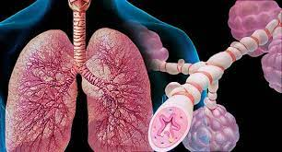
Bottom Line
Asthma is a serious disease that affects about 25 million Americans and causes nearly 1.6 million emergency room visits every year.
Despite this, there are still gaps that should be examined to reduce the burden of disease in disadvantaged communities.

Slide 17
References
Introduction to Asthma
https://www.aaaai.org/Aaaai/media/Media-Library-
Epidemiology of Asthma in Children and Adults
https://www.frontiersin.org/articles/10.3389/fped.2019.00246/full
AAFA Asthma Capital Records May 2021
https://www.aafa.org/media/3040/aafa-2021-asthma-capitals-report.pdf
Managing Asthma in Low-Income, Underrepresented Minority, and Other Disadvantaged Pediatric Populations: Closing the Gap
https://www.proquest.com/docview/1939197649?parentSessionId=tpPj
LUPVBpY9uMbTZBQWYV9%2Bkinar%2BvVg1D2yLIGXHw%3D&pq-origsite=primo&accountid=38212

