Slide 1
Hamstring Strain
Temitope Odugbola

Slide 2
Introduction
Did you know Nearly one out of three hamstring strain injuries will recur, mostly within the first weeks of the athlete's return to sport (RTS)?
Popularly known as a Pulled Hamstring which happens when one or more of the hamstring muscles gets stretched too far just before your foot strikes the ground or overextending your leg.
The purpose of this study is to establish whether the causes of reinjury are intrinsically derived from the initial injury (i.e., incomplete healing process) or the result of suboptimal rehabilitation.
Communication

Slide 3
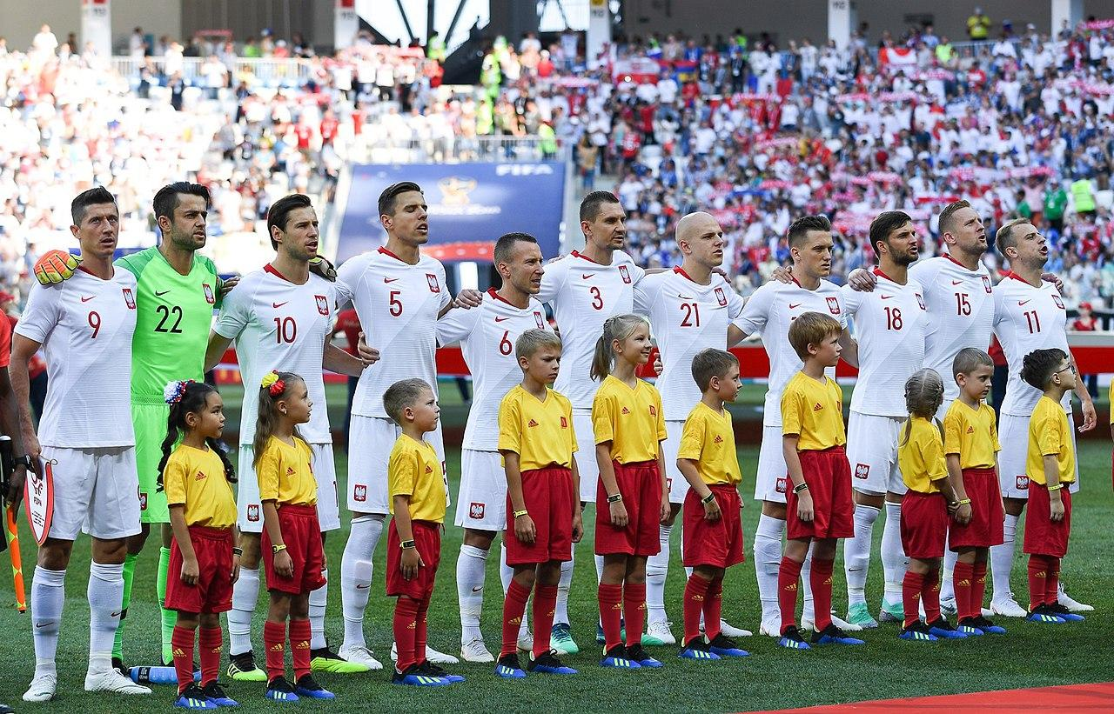
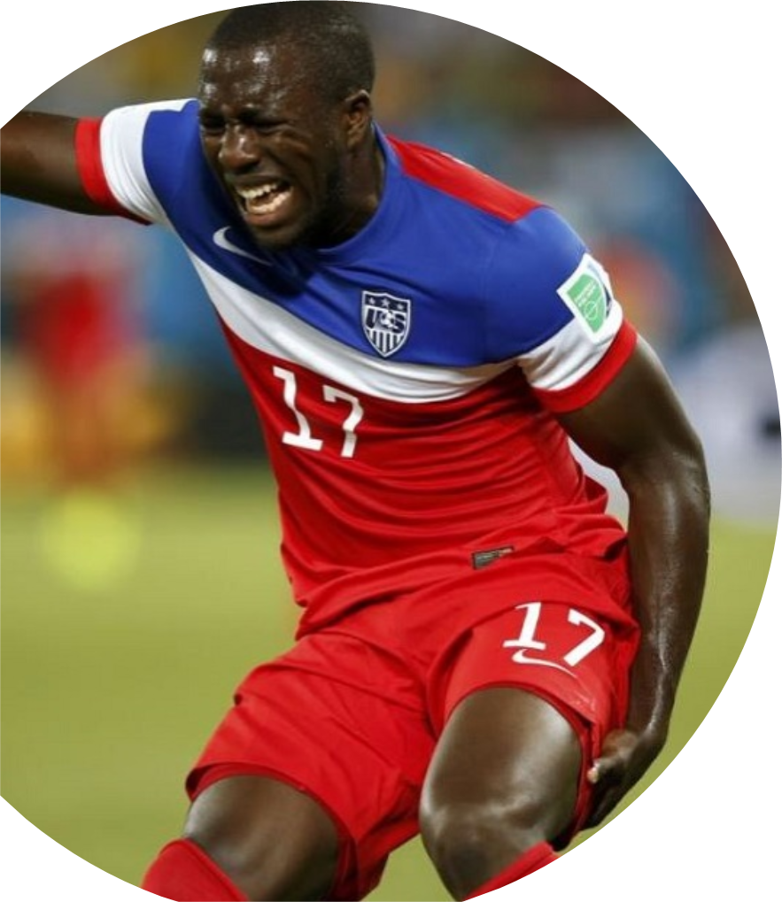
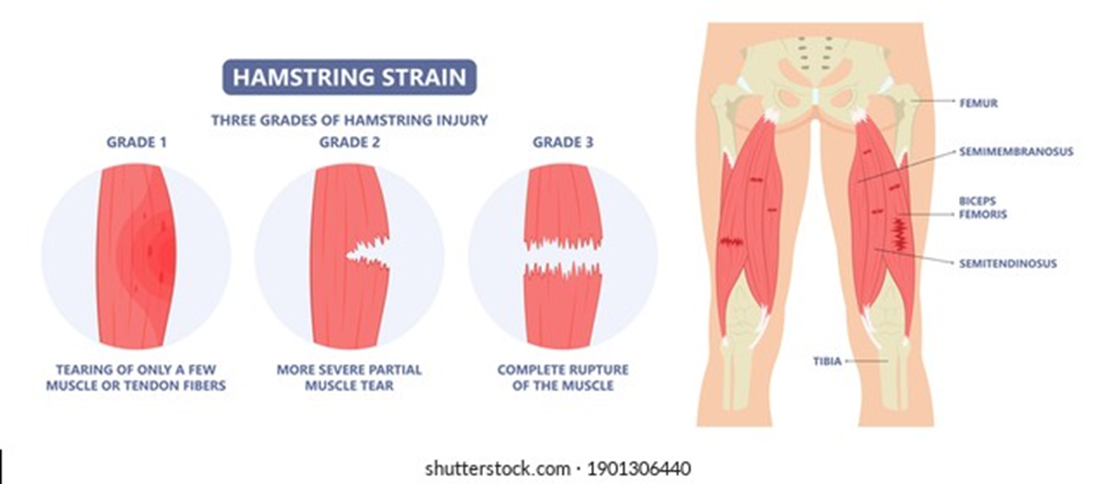

Slide 4
Subjects
Potential patients from football teams within the southeast region of Spain were attracted and recruited.
They had to be at least 16 years old male
Play for a semi pro/pro football team
Suspected to have a hamstring strain that occurred during training or a match.
Only has a grade 1 hamstring strain.
Players with previous hamstring strain were deemed ineligible to perform in the study.
Grade 2 strain and above strains are sent to an actual therapist to get full care to avoid risking players health or making the injury worse.
Cultural Diversity and Ethics

Slide 5
Methods
Civic Responsibility
The same sport med physician and radiology with over 20 years of experience in their field checked for pain and/or weakness with resisted knee flexion at 15° measured with a handheld dynamometer, and verified the grade of severity of all hamstring strain injuries using ultrasonography.
24 football players(48 total) were picked using a double-blind randomized controlled trial approach and they were put in either an Rehab Algorithm(RA) group or a validated General Rehab protocols(RP) group 5 days after an acute hamstring injury.
https://journals.lww.com/acsm-msse/_layouts/15/oaks.journals/ImageView.aspx?k=acsm-msse:2017:07000:00025&i=T2-25&year=2017&issue=07000&article=00025&type=Fulltext
Technical Competence

Slide 6
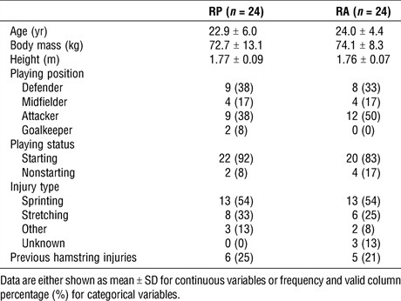
Quantitative Reasoning

Slide 7
Results
Within 6 months after return to sport, six hamstring injuries occurred in the General Rehabilitation Protocol versus one injury in Rehabilitation Algorithm.
Rehabilitation Algorithm players showed substantially better 10-m time, maximal sprinting speed, and greater mechanical variables related to speed than the General Rehabilitation Protocol.
https://journals.lww.com/acsm-msse/_layouts/15/oaks.journals/ImageView.aspx?k=acsm-msse:2017:07000:00025&i=T4-25&year=2017&issue=07000&article=00025&type=Fulltext

Slide 8
Discussion
Integrating the temporal sequencing of the different and multiple risk factors related to hamstring injury with a performance oriented training program from the early stages of the process, markedly decreased reinjury risk compared with the RP where long-length strength training exercises are prioritized. In this way at RTS, the player who followed the RA presented a lower risk compared with a typical footballer with no history of previous injury
No further research was said to be conducted to increase the scale of the study because there was no internal or external funding in support of this project.

Slide 9
Conclusion
Although return to sport was slower, male football players who underwent an individualized, multifactorial, criteria-based algorithm with a performance- and primary risk factor-oriented training program from the early stages of the process markedly decreased the risk of reinjury compared with a general protocol where long-length strength training exercises were prioritized.

Slide 10
Clinical Bottom Line
Even though the recovery time and rehab are a little bit longer than the general protocol I will still recommend the Rehabilitation Algorithm to be used because it reduces the chances of re-injury which is a big deal due to how much worse the injury can get. However the study was performed on a small sample size and only on grade one injuries which is the most common but not as severe as other strains so the algorithm is not fully ready for every hamstring strains.

Slide 11
Reference
Mendiguchia. J, Martinez-Ruiz. E, et al. A multifactorial, criteria-based progressive algorithm for hamstring injury treatment, medicine & science in sports & exercise. Medicine & Science in Sports & Exercise. 2017; 49(7); 1482-1492.
Timothy, D. Hamstring strain. Teens Health. 2016.

