Slide 1
Eat Right to Smile Bright

Slide 2
The American Diet
The average American family spends half their food budget on eating out
Notes:
https://www.valuepenguin.com/how-much-we-spend-food

Slide 3
Why People Choose To Eat Outside Food?
It is cheap and fast
It’s convenient
Busy schedule
Lazy or tired to cook
It’s everywhere
No lunch
Taste good

Slide 4
The Facts on Eating Out
Foods are high in:
Sugar
Salt
Sodium
Trans Fat
Saturated fat
Cholesterol
Calories
Increased temptation to over indulge
Large portion size

Slide 5
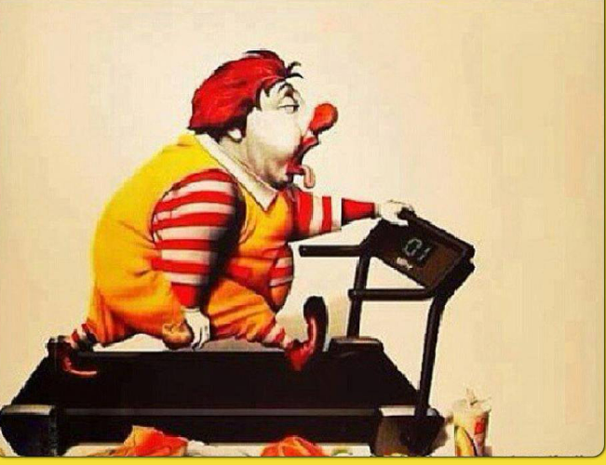
How Does it Affect Your Health?
Increase body weight
Excess body weight relates to low-grade systemic inflammation and impairs health
Increase risk of developing type 2 diabetes/insulin resistance
Increased risk for CVD
It affects the periodontium
Increases blood pressure
Increase risk of acne breakouts

Slide 6
Obesity and Oral Health
-An inflammatory infections that changes the tissue that supports the teeth
-There is continuous release of proinflammatory cytokines from adipose tissue into the system providing a systemic inflammatory overload
-Some studies show a reduction in the saliva flow but is still being debated, placing people at higher risk for developing caries
-It is a condition of multifactorial origin where systemic and local factors play a major role
-It is influenced by age, smoking, oral hygiene, socioeconomic status, genetic, race, gender, stress, and obesity
Notes:
Obesity extremely prevalent worldwide

Slide 7
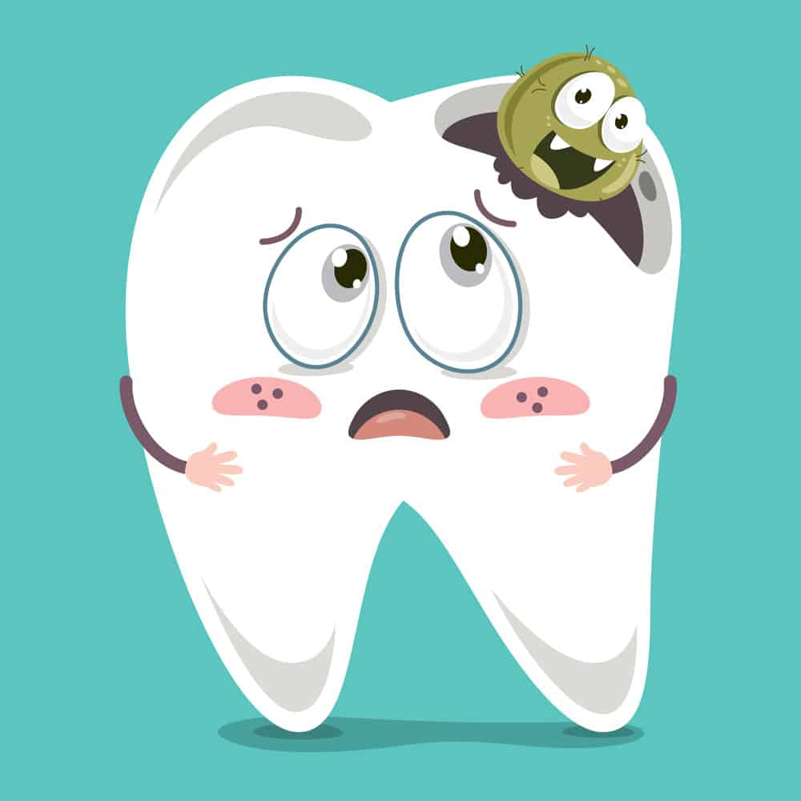
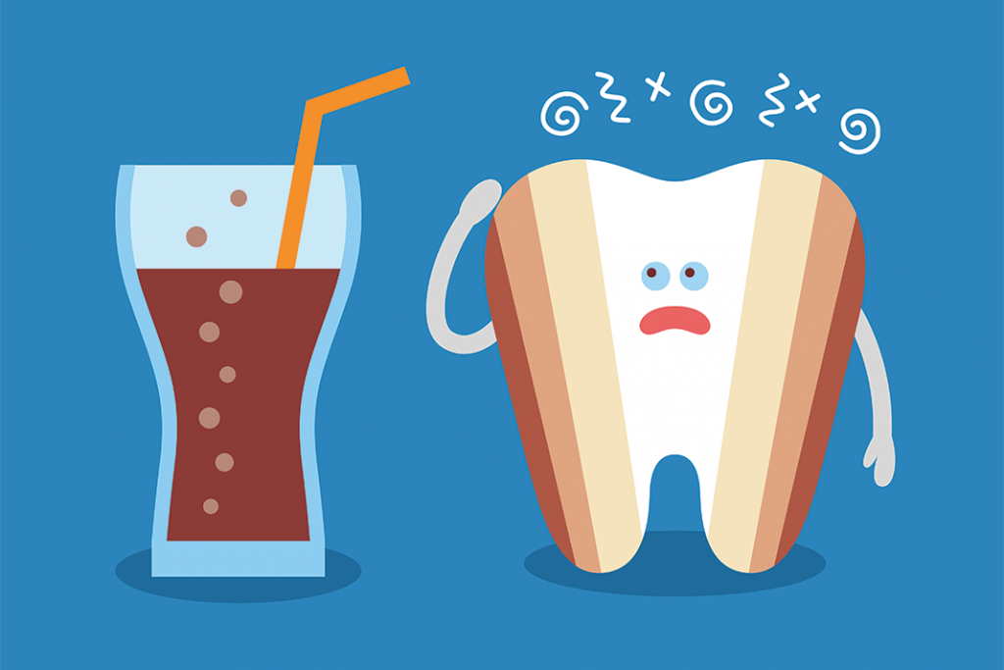
Diet & Nutrition and Oral Health
There is a bidirectional relationship
Excess intake of sugar increases risk of dental caries
Frequent consumption of acidic foods and beverages increases risk of tooth erosion
Notes:
“Diet and nutrition affect the health of the tissues in the mouth; and the health of the mouth affects nutrients consumed.” from the ADA
“Oral infectious diseases, as well as acute, chronic, and terminal systemic diseases with oral manifestations, impact the functional ability to eat as well as diet and nutrition status. Likewise, nutrition and diet may affect the development and integrity of the oral cavity as well as the progression of oral diseases.”

Slide 8
Let’s Choose Healthier Foods
The Good Fats
Monounsaturated fats
Avocado
Olive oil
Canola oil
Nuts
Polyunsaturated fats
Salmon
Mackerel
Sunflower seeds
Walnuts
Tips
Avoid certain menu items that say
Fried
Braised
Buttered
Pan-fried
Cream sauce
Cheesy
Don’t be afraid to ask:
Chefs can remove/reduce the amount of oil, salt, and butter
Dressing/sauce on the side
Reduce frequency of eating out
Choose water
Notes:
The AHA (American Heart Association): Recommends eating foods with unsaturated fats over saturated fats as studies show this can decrease the risk of heart disease
Monounsaturated fats help reduce bad LDL cholesterol and are typically liquid at room temperature.
Polyunsaturated fats also help to reduce cholesterol

Slide 9
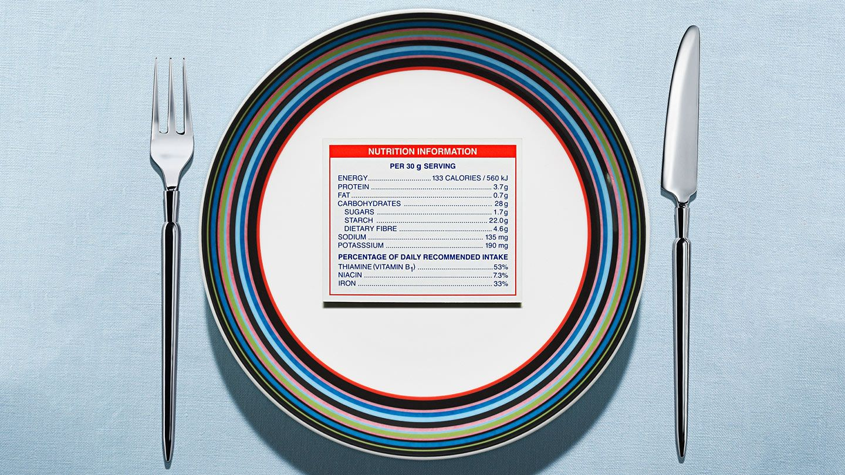
Daily Calorie Intake

Slide 10
Recommended for…
WOMEN
2,000 calories a day
MEN
2,500 calories a day
Calories = Energy
Factors to take into consideration:
Age: growing children/teenagers
Lifestyle: how active you are
Size: how quickly you use energy
Hormones: chemicals produced by the body (thyroid)

Slide 11
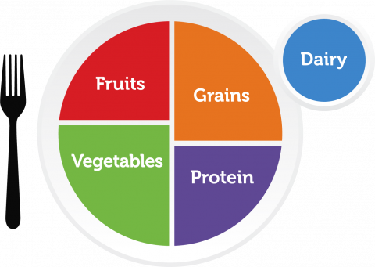
Recommended %
Carbohydrates
55%-65% of total calorie intake
Lipids
Limit to 30% of total calorie intake
Protein
Needs are based on body weight and, not energy intake.
Average intake is approx.
100 g/day for men
69 g/day for women

Slide 12
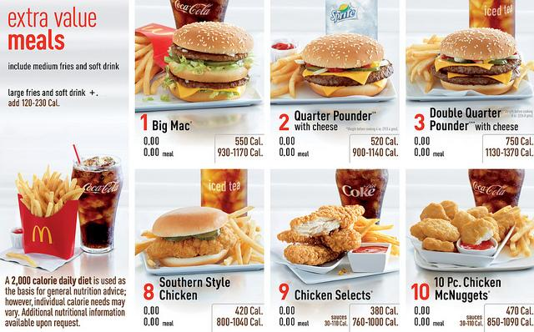
Nutritional Facts Available
New law enacted by the Federal Drug Administration (FDA) in 2018.
Restaurants must provide nutritional facts
Notes:
Any restaurant with more than 20 locations must provide customers with a calorie count of their food items

Slide 13
Alternative Options

Slide 14
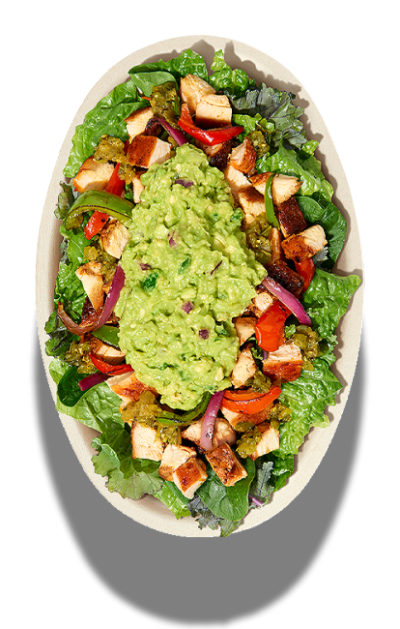
Chipotle: Salad Bowl
Add beans for extra fiber and protein
Add chicken or sofritas (tofu)
Add fajitas topping for extra veggies
Skip the rice, cheese, and sour cream

Slide 15
Domino’s: Crunchy Thin Crust Pizza
Substitute toppings for veggies
Add chicken for a bit of protein
Less dough; fewer carbohydrates
Notes:
contains 110 calories, 4.5g fat, 0.5g saturated fat, 15g carbohydrates, 2g protein, and 40mg sodium

Slide 16
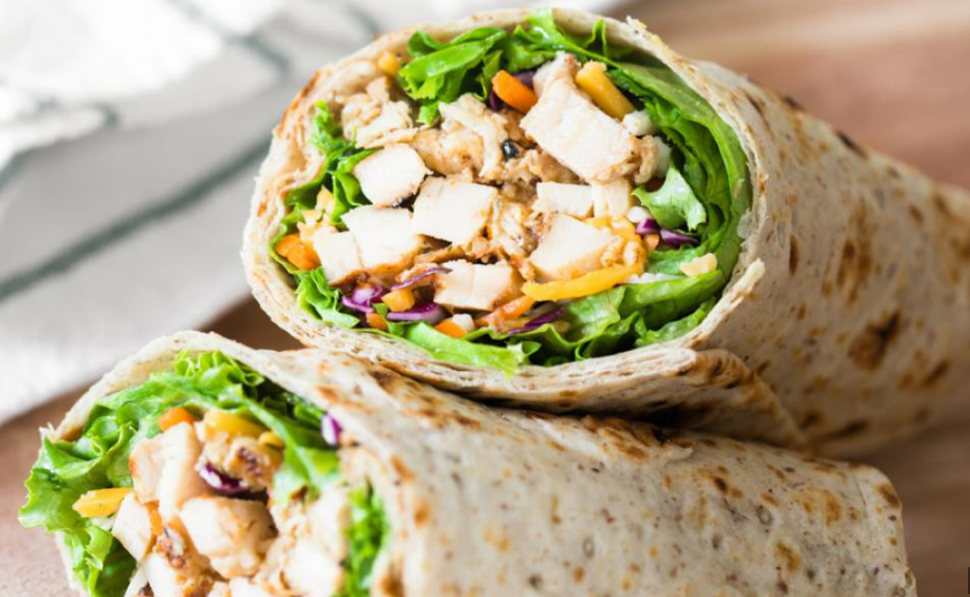
Lettuce Be Together Forever
C
Go for a Grilled Chicken Wrap at Chick-Fil-A. It contains cheese, lettuce, red cabbage, and carrots wrap in a flatbread high in fiber. It contains 15 grams of fiber, 14 grams of fat, and 37 grams of protein. This meal provides you with 350 calories.

Slide 17
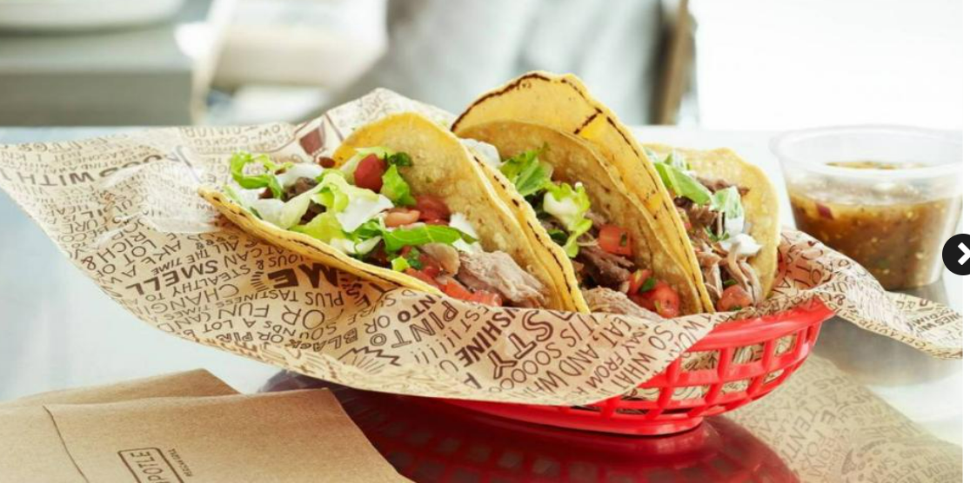
SpecTacolar
An alternative choice is soft tacos. Use corn tortilla instead of flour because they are lower in calories, high in fiber, and contain no sodium.
Notes:
Substitute the chicken with sofritas which is plant-based protein with chipotle chilis, roasted poblanos, and spices
add more veggies and hold on the cream

Slide 18
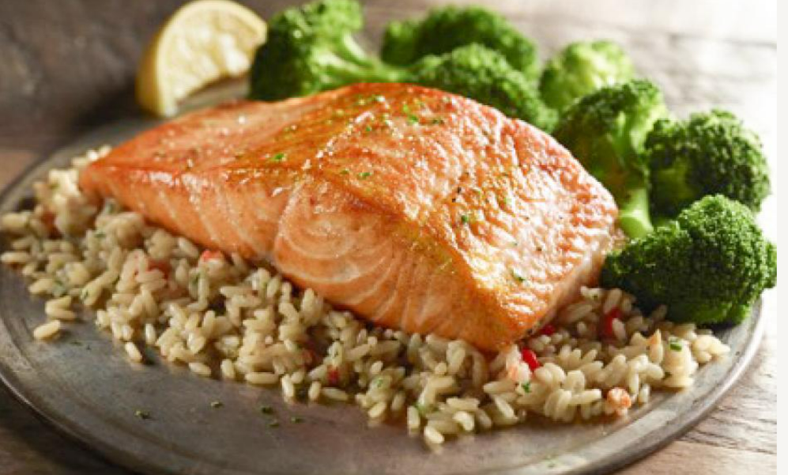
Salmon & Veggies
Opt for brown rice instead of white rice
Add a generous side of veggies
Rich in omega 3 fatty acids
Notes:
Brown rice has Vitamins B12, Vitamin D, Potassium, and Iron. Low in saturated fat and good source of protein

Slide 19
Let’s do a POLL
Please go to:
https://pollev.com/mariabravo581

Slide 20
Thank you for your participation
References
Bhutani, S., Schoeller, D. A., Walsh, M. C., & McWilliams, C. (2018). Frequency of Eating Out at Both Fast-Food
and Sit-Down Restaurants Was Associated With High Body Mass Index in Non-Large Metropolitan
Communities in Midwest. American journal of health promotion : AJHP, 32(1), 75–83.
https://doi.org/10.1177/0890117116660772
Center for Food Safety and Applied Nutrition. (n.d.). Changes to the nutrition facts label. U.S. Food and Drug
Administration. https://www.fda.gov/food/food-labeling-nutrition/changes-nutrition-facts-label
Deshpande, N. C., & Amrutiya, M. R. (2017). Obesity and oral health - is there a link? an observational study. Journal of
Indian Society of Periodontology, 21(3), 229. https://doi.org/10.4103/jisp.jisp_305_16
Jennings , K.-A. (n.d.). The healthiest dishes at 30 major restaurant chains. Food Com. Retrieved May 9, 2022, from
https://www.foodnetwork.com/restaurants/photos/healthy-restaurant-menus

Slide 21
References
Nutrition and oral health. American Dental Association. (n.d.). Retrieved May 8, 2022, from
https://www.ada.org/resources/research/science-and-research-institute/oral-health-topics/nutrition-and-oral-health
Roa, I., & del Sol, M. (2018). Obesity, salivary glands and oral pathology. Colombia
Medica, 49 (4), 280-287. https://doi.org/10.25100/cm.v49i4.3919
Touger-Decker R, Mobley CC, American Dietetic Association. Position of the American Dietetic Association: oral health and
Nutrition and oral health. American Dental Association. (n.d.). Retrieved May 8, 2022, from
https://www.ada.org/resources/research/science-and-research-institute/oral-health-topics/nutrition-and-oral-health

