Slide 1
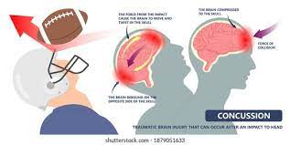
Concussions

Slide 2
Introduction
Concussions in American football and the NFL are a major area of interest and key focus for injury prevention & safety.
A total 1302 concussions were identified from 2015 to 2019 among 1004 players.

Slide 3
Research
Medical staff use the EHR(electronic health record) for clinical care and are trained throughout the year to standardize reporting,
Incidence rate of game-related concussions was calculated as the rate per 10,000 player-plays to account for the number of plays in which each individual player participated as recorded in GSIS.

Slide 4
Results
Table 1.
Concussion incidence by year, 2015-2019a
 | 2015 | 2016 | 2017 | 2018 | 2019 | 5-Year Average (Column %)
Season
Offseason | 5 | 5 | 10 | 5 | 8 | 6.6 (2.5)
Preseason | 83 | 71 | 92 | 80 | 79 | 81.0 (31.1)
Regular season | 192 | 172 | 190 | 135 | 145 | 166.8 (64.1)
Postseason | 4 | 7 | 10 | 3 | 6 | 6.0 (2.3)
Team activityb
Game | 241 | 217 | 234 | 164 | 190 | 209.2 (80.3)
Practice | 43 | 38 | 67 | 58 | 48 | 50.8 (19.5)
Conditioning/other | 0 | 0 | 1 | 1 | 0 | 0.4 (0.2)

Slide 5
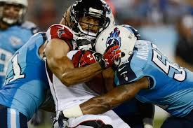
Discussion
a rate of 70.6 and 61.7 concussions per 100 games in preseason and regular season, respectively.

Slide 6
Conclusion
Incidence and prevalence of concussion in football have been reported and studied extensively at the youth,6,33 middle school,2 high school,22,30,35-37,41 and collegiate levels.17,18,34,42

Slide 7
Clinical bottom line
The decreased incidence observed in 2018 and 2019 has provided a new benchmark from which to work toward further reduction in concussive injury in the NFL.
A detailed analysis of the study by Dai et al12 indicates that neither practice nor game concussions during the preseason, bye weeks, or postseason were included; these are remarkable omissions since they represent a key component of concussion incidence in the NFL.

Slide 8
Citation
Christina D. ,MacGary Solomon, Tracey Covassin, Nicholas Theodore, Javier Cárdenas Allen Sills Epidemiology of Concussion in the National Football League, 2021;13(5):423-440

