Slide 1
Vitamin C

Slide 2
Introduction
Also known as Ascorbic Acid
Antioxidant that helps protect your cells against the effects of free radicals
Involved in the regulation of function, development, and cells within the body
Essential nutrient found in fruits and vegetables
Needed in small amounts for normal body function:
Formation of collagen
Absorption of iron
Proper functioning of the immune system
Wound healing
Maintenance of cartilage, bones, and teeth

Slide 3
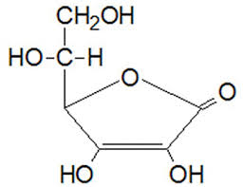
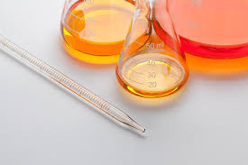
Biochemistry Knowledge
A water-soluble compound and is necessary for enzyme activation, oxidative stress reduction, and immune function
Most heat labile vitamin and acts as a strong reducing agent
An essential nutrient that cannot be made
Humans cannot synthesize or store ascorbic acid due to deficiency of single enzyme L-gulonolactone oxidase
Must be obtained from diet
Rapidly absorbed in the intestine and excreted in urine
Involved in synthesis of collagen fibers

Slide 4
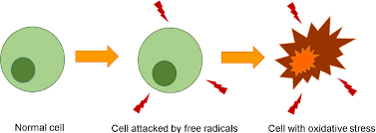
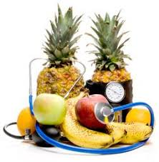
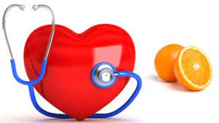
Current Status
Systemically beneficial in prevention of certain cancers, including mouth cancer.
Antiatherosclerosis and anti-cariogenic properties (slows the progression)
Lowers risk of hypertension.
Dietary Approaches to Stop Hypertension (DASH) recommended by nutritionists to have plenty of Vitamin C which contains antioxidants.

Slide 5
Health Benefits
Powerful antioxidant and protector of the cells and DNA
Key factors in the synthesis of collagen
May have anti-aging effects
May prevent and alleviate diverse infections and common cold
May boost the immune system
May reduce blood pressure
May lessen the risk of heart disease
May help prevent iron deficiency anemia
May improve the healing of pressure ulcers
Might protect against cognitive impairment and alzheimers disease
May improve mood
May lower LDL cholesterol (bad cholesterol)

Slide 6
Periodontal Health
Benefits of Vitamin C on the Periodontium
Maintains periodontium
↓ risk of periodontal disease
Promotes healing
Antioxidant content
Restores tissues in wound healing
Forms new collagen
Can assist in the prevention of tooth loss

Slide 7
RDA
For healthy individuals
Adult males
90 mg/day
Adult females
75 mg/day
Children
Depends on age and gender
15-65 mg/day
Infants
40-50 mg/day
Pregnant or lactating
15 mg above RDA (pregnant)
50 mg above RDA (lactating)
Smokers
35 mg above RDA

Slide 8
Concept/Problems
Tobacco users are at high risk of vitamin C deficiency
Deficiency can lead to:
Scurvy
Bone pain
Impaired wound healing
Impaired bone growth
Lethargy
Myalgia
Pseudoparalysis
Gingivitis/Periodontal disease
Especially in smokers
Weakened tooth enamel
Anemia
Bone pain/↑ risk of osteoporosis
Impaired immunity
↑ susceptibility to infection
Various medical condition(s)
Notes:
Deficiency of Vitamin C can lead to scurvy which can cause gingivitis, bone pain, impaired wound healing, lethargy, myalgia, impaired bone growth, and pseudoparalysis. Poor oral health can affect an individual’s ability to eat certain nutritious foods while poor nutrition can increase an individual’s risk of poor oral health including periodontal disease and tooth loss.

Slide 11
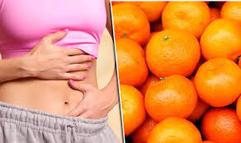
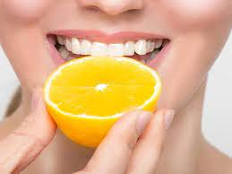
Concept/Problems
Concept/Problems
Overdose may cause digestive discomfort:
Nausea
Diarrhea
Stomach cramping and bloating
General abdominal discomfort
May cause dental erosion/tooth wear
Taking vitamin C in high doses cause vitamin B-12 deficiency
Toxicity is rare

Slide 12
Conclusion
Vitamin C deficiency and insufficiency persists and likely contribute to suboptimal bone health.
The effect on bone health is vital and has proven to be regulated through a series of complex mechanisms of interaction.
Supports epithelial barrier function against pathogens
Vitamin C deficiency results in impaired immunity and higher susceptibility to infections.

Slide 13
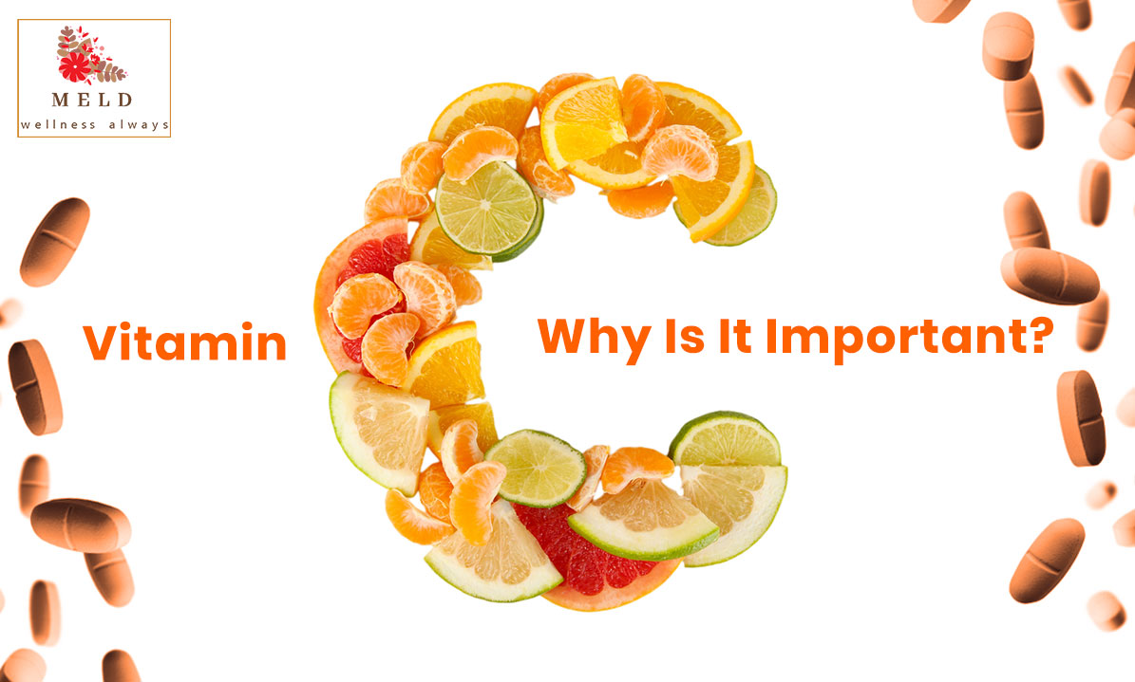
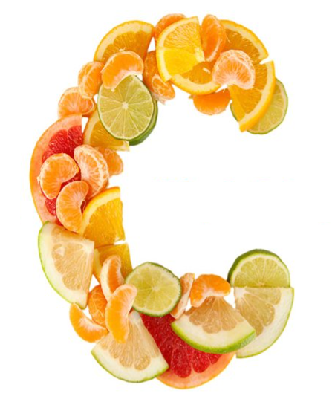

Slide 14
References
Carr, C. A. & Maggini, S. 2017. Vitamin C and immune function. National Library of Medicine. 9(11) 1211
National Institutes of Health. “Office of Dietary Supplements - Vitamin C.” Nih.gov, 26 Mar. 2021, ods.od.nih.gov/factsheets/VitaminC-HealthProfessional/.
“Vitamin c (Ascorbic Acid) Information | Mount Sinai - New York.” Mount Sinai Health System
Cecchini-259, Jill. “Vitamin c Update: Implications for Periodontal Health and Healing.” Oral Health Group, 12 Oct. 2017
Aghajanian, P., Hall, S., Wongworawat, M. D., & Mohan, S. (2015, September 11). The Roles and Mechanisms of Actions of Vitamin C in Bone: New Developments. Wiley Online Library. asbmr.onlinelibrary.wiley.com. 30(11), 1945-1955.

