Slide 1
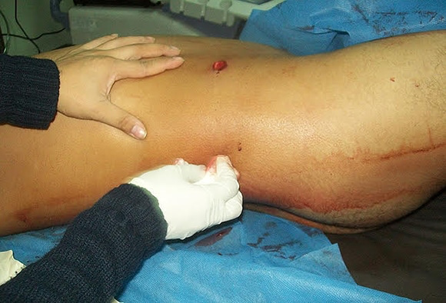
Complication & treatment to liver by gunshot
Dalia R

Slide 2
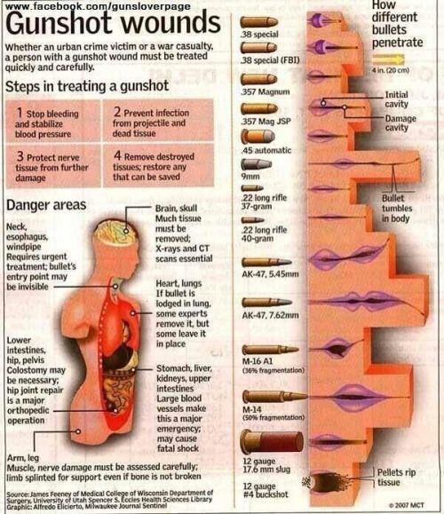
Introduction
Gunshot wounds are a result of a bullet or other projectile entering through the body.
The amount of damage depends on the location of injury, the speed and the type of bullet.
Head & body shots tend to cause more damage due to the vital organs
High velocity wounds with fracture give a higher risk of infection.

Slide 3
Introduction
Average death per year: 40,620
Notes:
2016-2020 data obtain

Slide 4
The US gun homicide rate is 26 times that of other high-income countries.
Gun homicides are concentrated in cities—half of all gun homicides took place in just 127 cities, which represented nearly a quarter of the US population.
Notes:
https://everytownresearch.org/report/gun-violence-in-america/

Slide 5
Subject:
A study was conducted on 53 patients admitted to the Department of Surgery with LT (liver trauma) caused by a GSW were reviewed.(2011-2015)
In addition to Liver trauma and GSW other injured organs were analyzed
Posttraumatic arthritis may be caused by mechanical symptoms and subsequent destruction of the joint. (accumulation of fluid)
Damage that occurs include bleeding, infection of a wound, broken bone, organ damage, loss ability of movement in the body, or death.

Slide 6
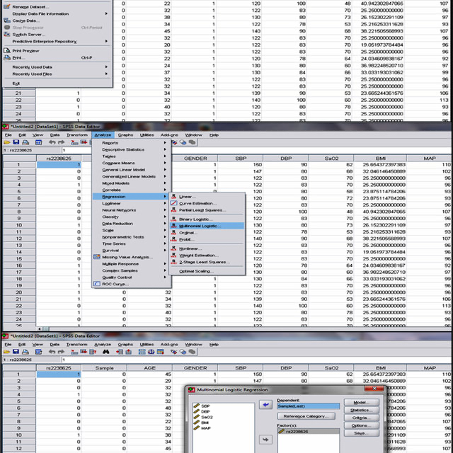
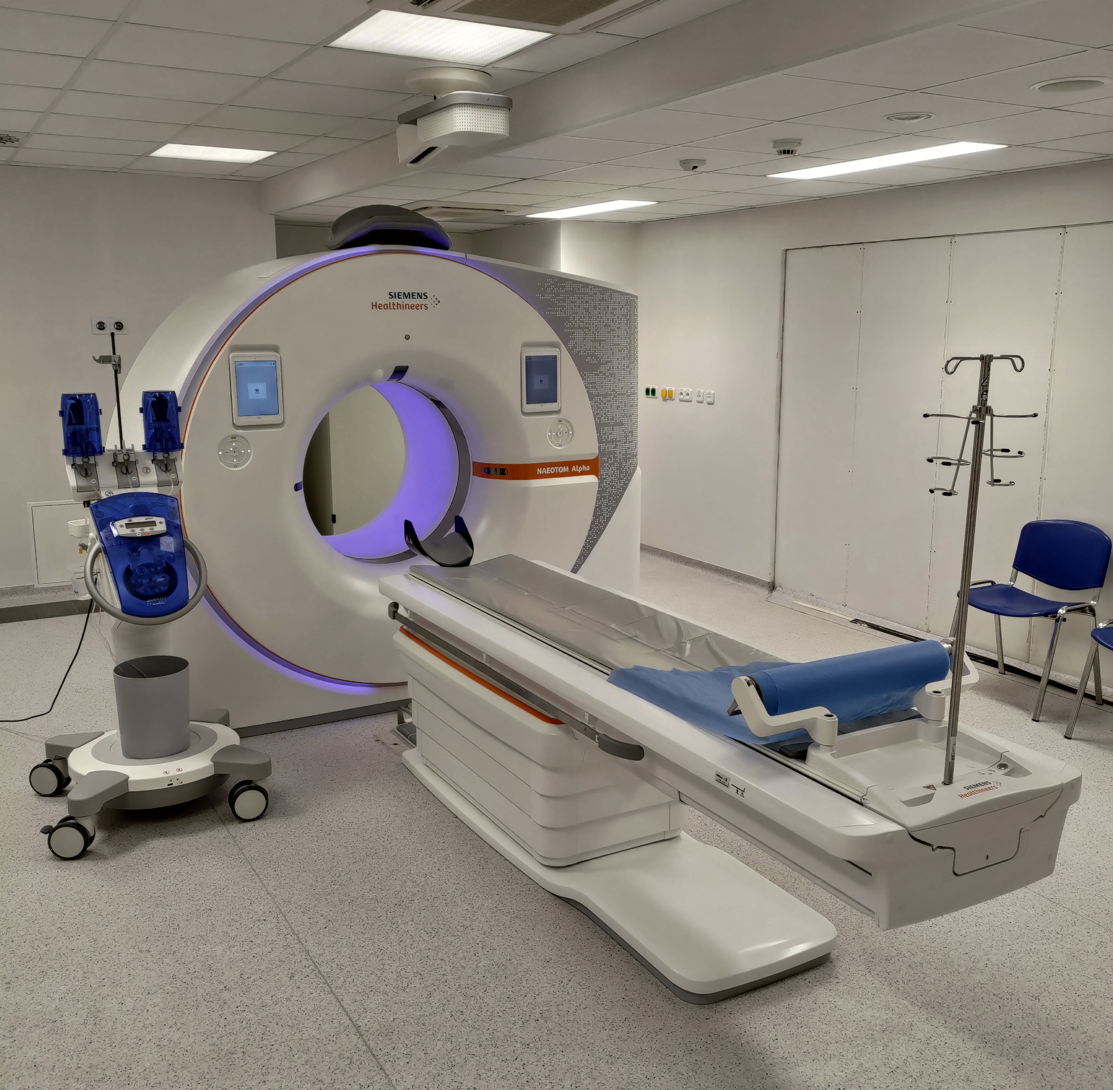
Methods
Data were collected on the number of injured organs, sex, age, number of days in hospital, number of days in intensive care,etc
The data was analyzed using a spreadsheet from the Numbers® v3.6.1 program
Statistical analysis was performed using the IBM SPSS Statistics v20.0 program

Slide 7
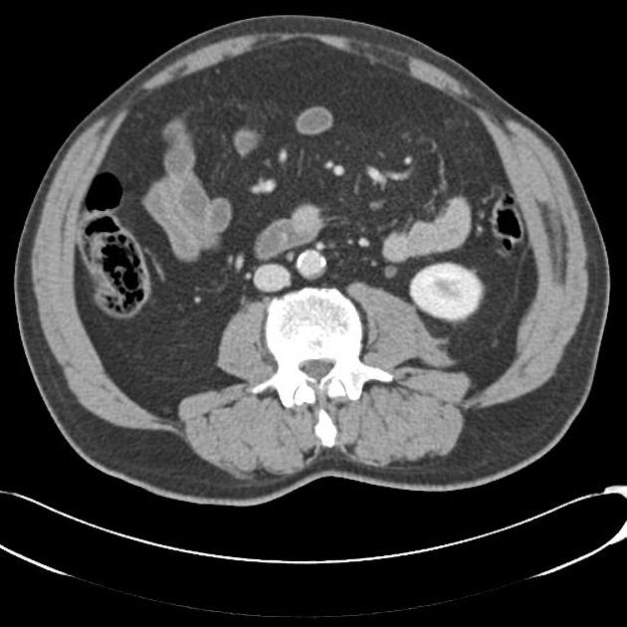
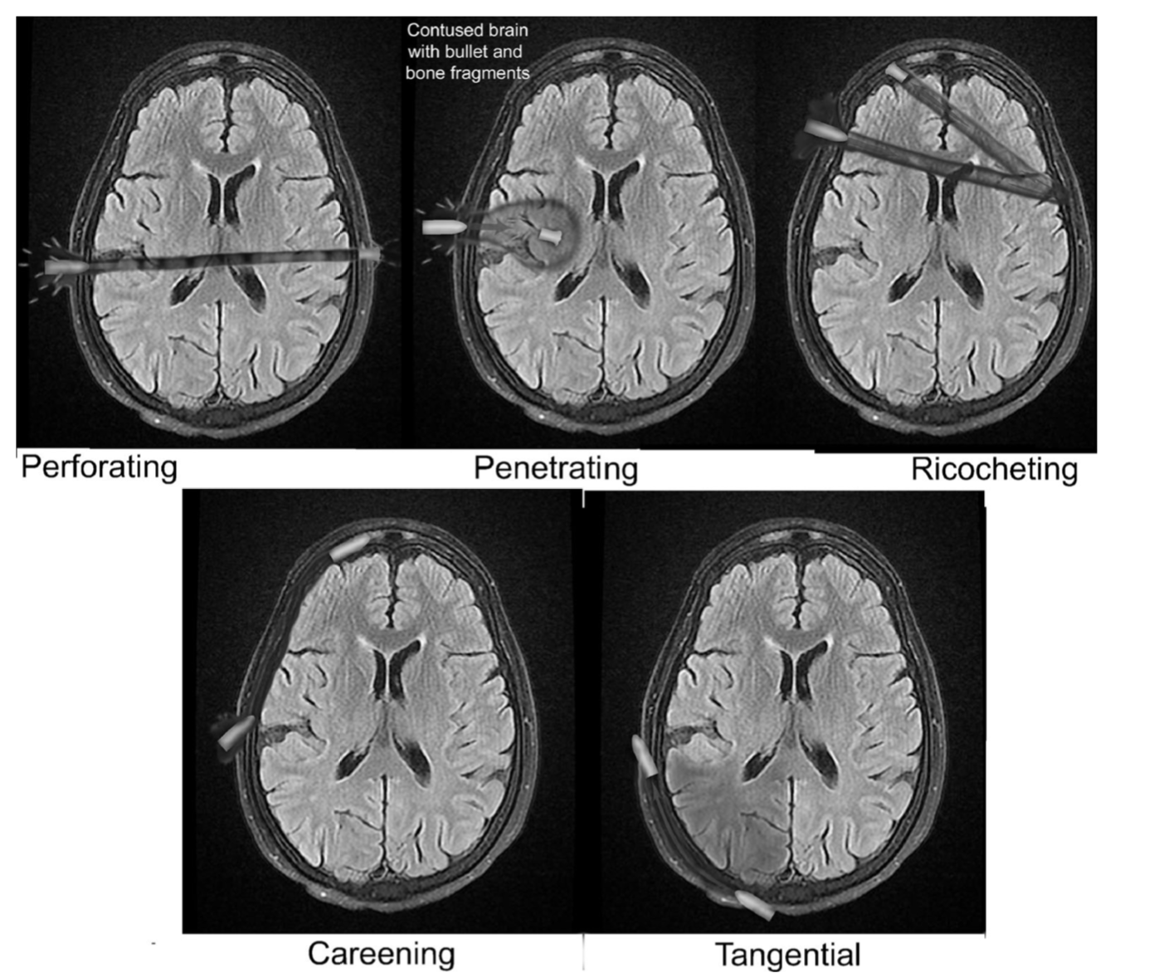
Methods
A CT scan can adequately identify the extent of an injury and can also determine the relationship between the penetrating object and the injured structures.
A plain radiography can also be documented to provide information about the following;
Shape of the penetrating object, skull fractures , and to determine the presence intracranial object,
It can also provide more detailed information about the liver, gallbladder, and related structures than standard X-rays of the abdomen,

Slide 8
Results
 | Number of complications | % Respect to the total sample (n=53) | % Respect to the total of complicated patients(n = 19) | Number of deaths related to complications (n = 9) | Number of complicated patients related to ICU stay (n = 20)
Wound dehenives | 8 | 15 | 42 | 0 | 0
Empyema | 6 | 11 | 32 | 1 | 6
Anastomosis leak | 3 | 6 | 16 | 1 | 1
Pancreatic fistula | 2 | 4 | 10 | 0 | 1
Total | 19 | 36 | 100 | 2 | 8

Slide 9
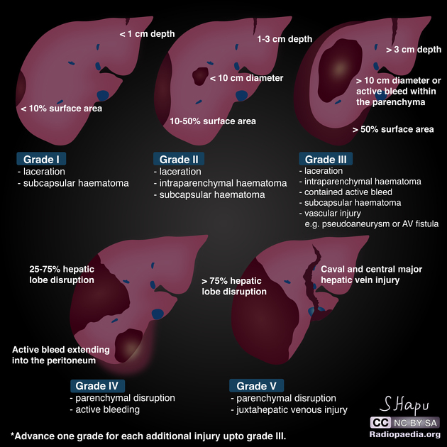

Slide 10
Results
2nd and 3rd liver lesion obtains the highest prevalence in the study.
100% of 4th lesion grade present complication.
Liver hemostasis was performed as the first therapeutic intervention for LT in 100%. The rest of the surgical procedures performed were specific to treat associated organ and non-organ lesions.
38% were admitted to the ICU because of LT, and 45% had a hospital stay ≥ 14 days without entering the ICU.
36% presented various complications, such as wound dehiscence, empyema, and anastomosis leak.
9%(5) females and 91% (48) males associated with liver trauma.

Slide 11
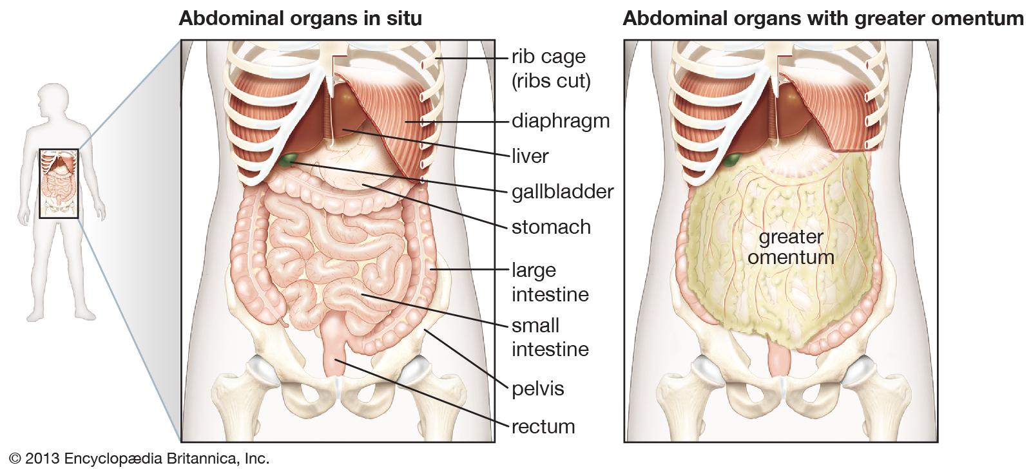
Discussion
​​​​Variables in this study revealed hemostasis as the initial treatment for LT. This mainly includes non-operative management. If not possible, laparotomy could be considered as the initial therapeutic measure. Laparotomy is a surgical incision into the abdominal cavity, which examines the organs. Invasive surgical techniques have declined because conservative treatment is successful in percentages close or equal to 100%. However, invasive methods should not be considered in disuse because of the associated lesions that the patient​​ may present.​​​​​​

Slide 12
Conclusion
The research found the lung was the organ that was most frequently injured together with liver trauma in 57% of living patients and 67% of dead patients in our study. In addition to an obvious hemothorax and therapeutic use of a chest tube . It was also found that most patients with LT did not require hospitalization in the ICU or the hospital ward for more than 14 days since they mostly had a one grade lesion. The use of prophylactic antibiotics with the chest tube is reserved for penetrating wounds, which is currently accepted to significantly reduce the length of hospital stay and the number of cases of empyema an. The study does suggest applicable statistics regarding the increase in the number of this type of lesion for the correct optimization of resources to reduce the reaction time between the injury moment to the time of require medication,

Slide 13
Clinical Bottom Line
​​This research can be sued in the clinical setting, although the study does suggest prominent variables to define the prognosis of the patient. It’s necessary to measure these variables separately and evaluate mortality in each of the groups. As well as locating and taking in consideration the severity of the type of wounds with different therapeutic options available, individualizing the procedure from hospital admission to post-operative management of complications or medical follow-up.

Slide 14
Citation/Reference
R. Cantú-Alejo, D., 2022. Complicaciones y tratamiento de herida hepática por proyectil de arma de fuego. Un enfoque retrospectivo | Cirugía y Cirujanos
Everytown Research & Policy. 2022. Gun Violence in America | Everytown AQ12 Research & Policy.

