Slide 1
Submitting your CCCApply Non-credit Application

Slide 2
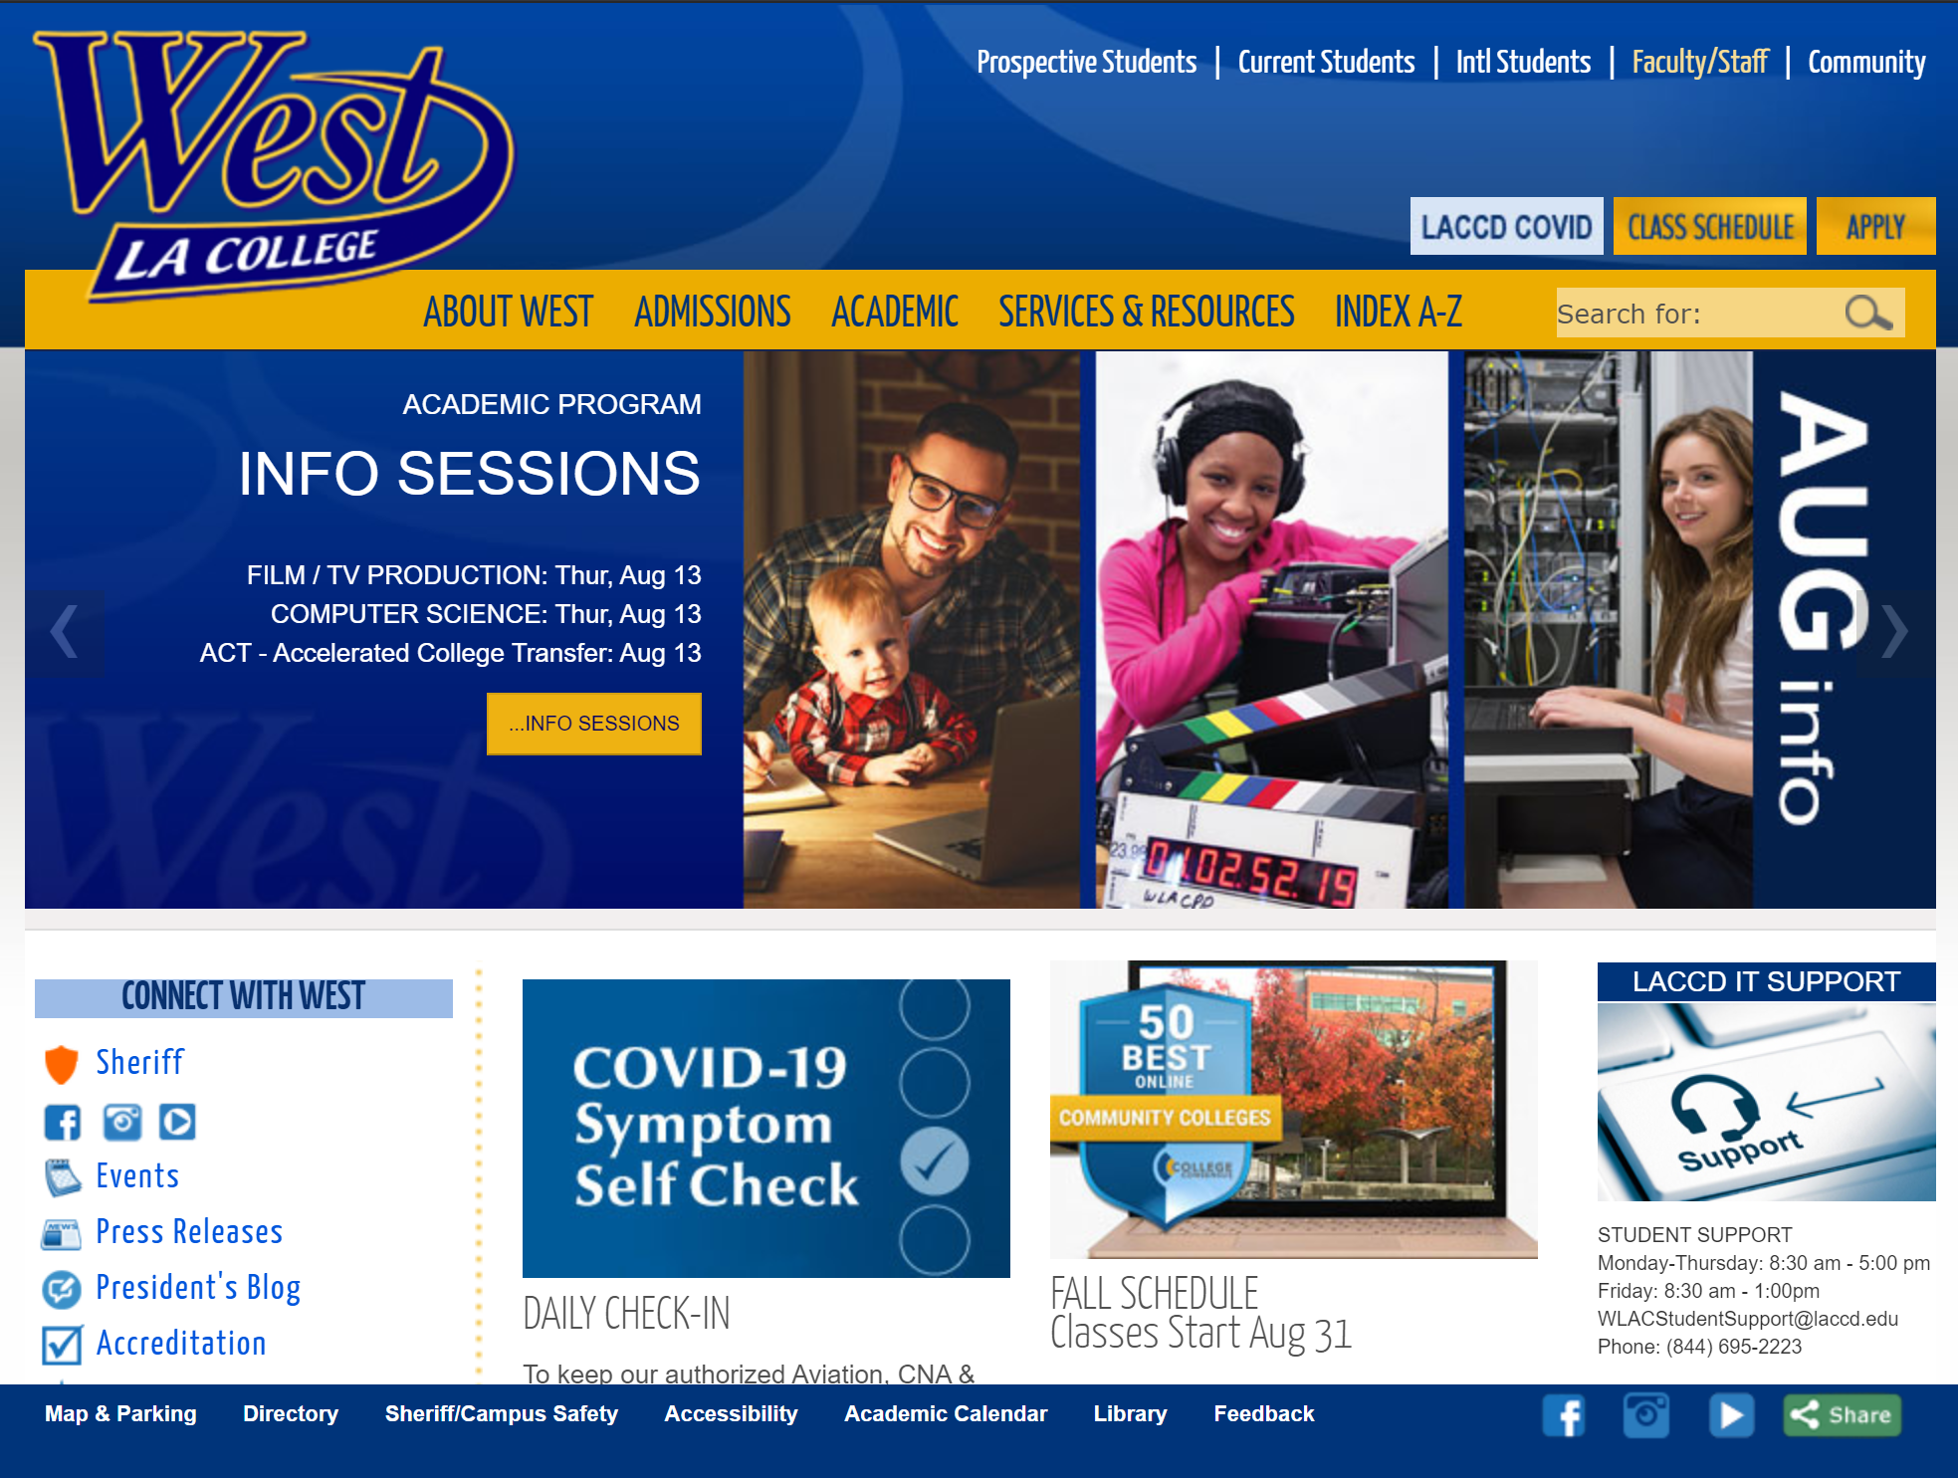
Visit the West LA College website www.wlac.edu
Click “Apply”

Slide 3
Begin Application
Click on the correct application- “CLICK HERE FOR NON-CREDIT APPLICATION”

Slide 4
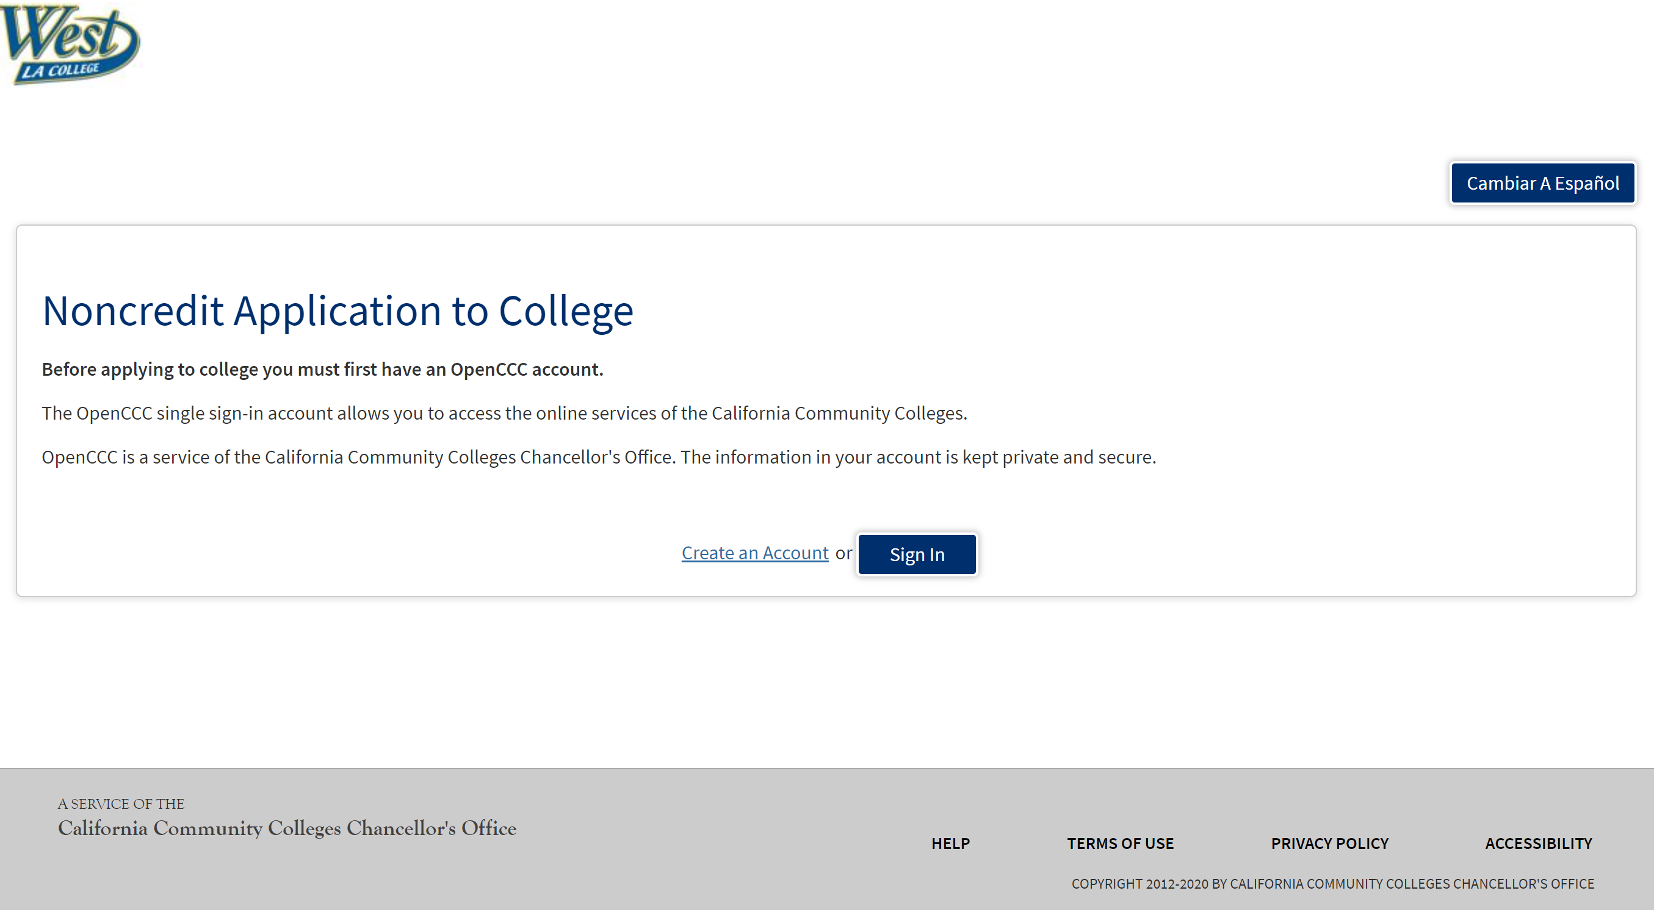
Create an Account
Click “Create an Account” if you have never submitted an application through CCCApply to other CA community colleges.
Click “Sign In” if you have submitted an application through CCCApply before. & Go to Slide #10

Slide 5
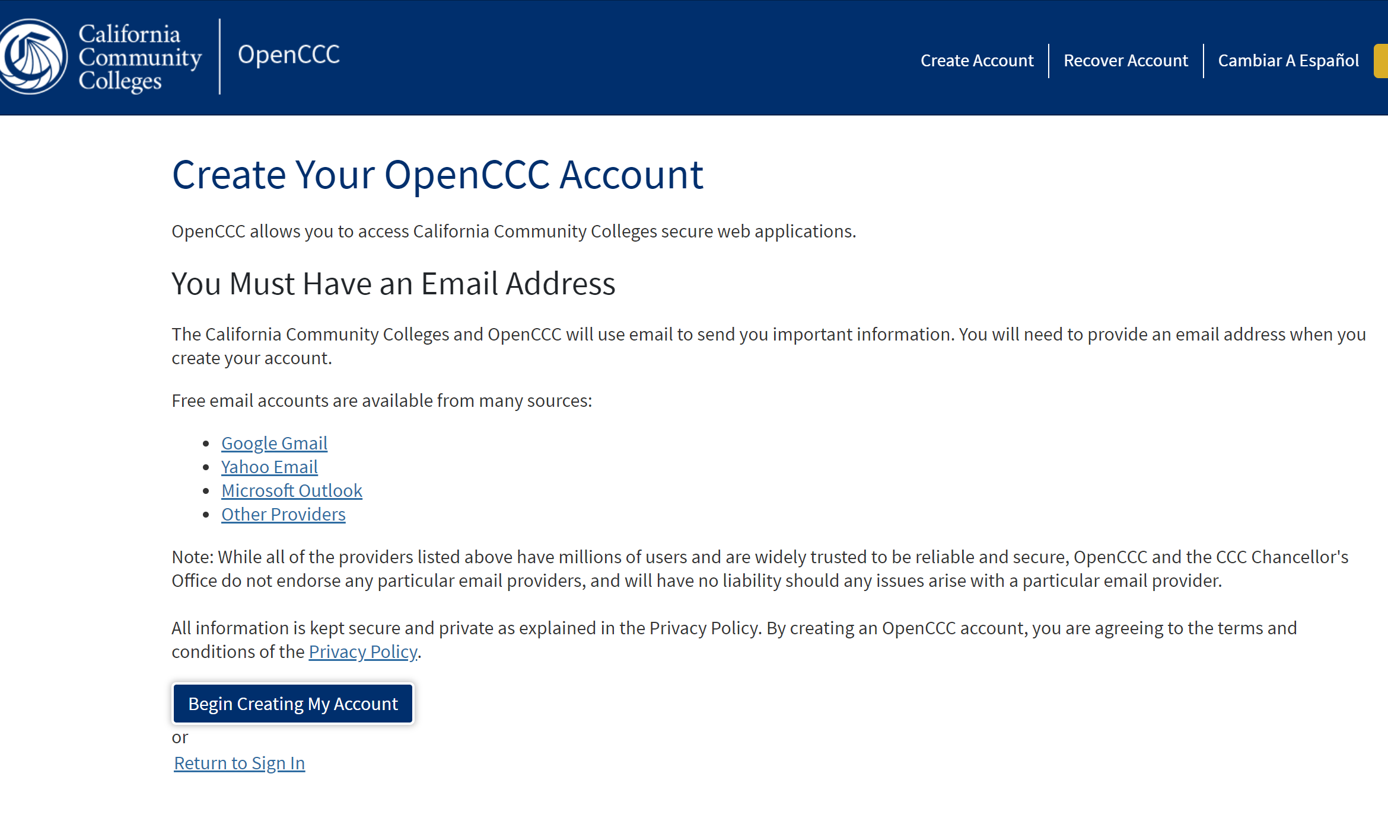
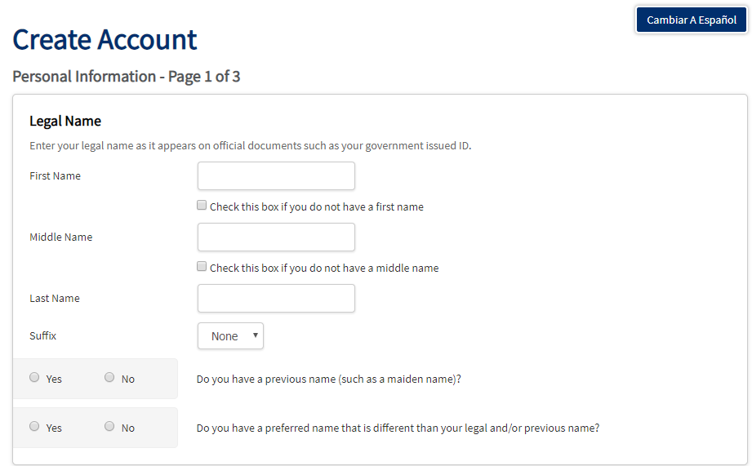
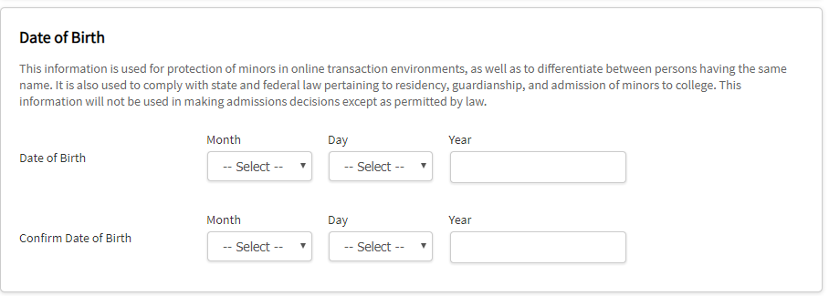
If you don’t have a cccapply, you will need to first
create an account and then begin the admission
application.
You can use your school email or a personal email,
make sure you write an email you check often, since
that’s where you will receive your student ID# within 3
to 5 business days from submission.
Fill out your complete name information and select Y/N in the questions below
Input and confirm your Date of Birth

Slide 6
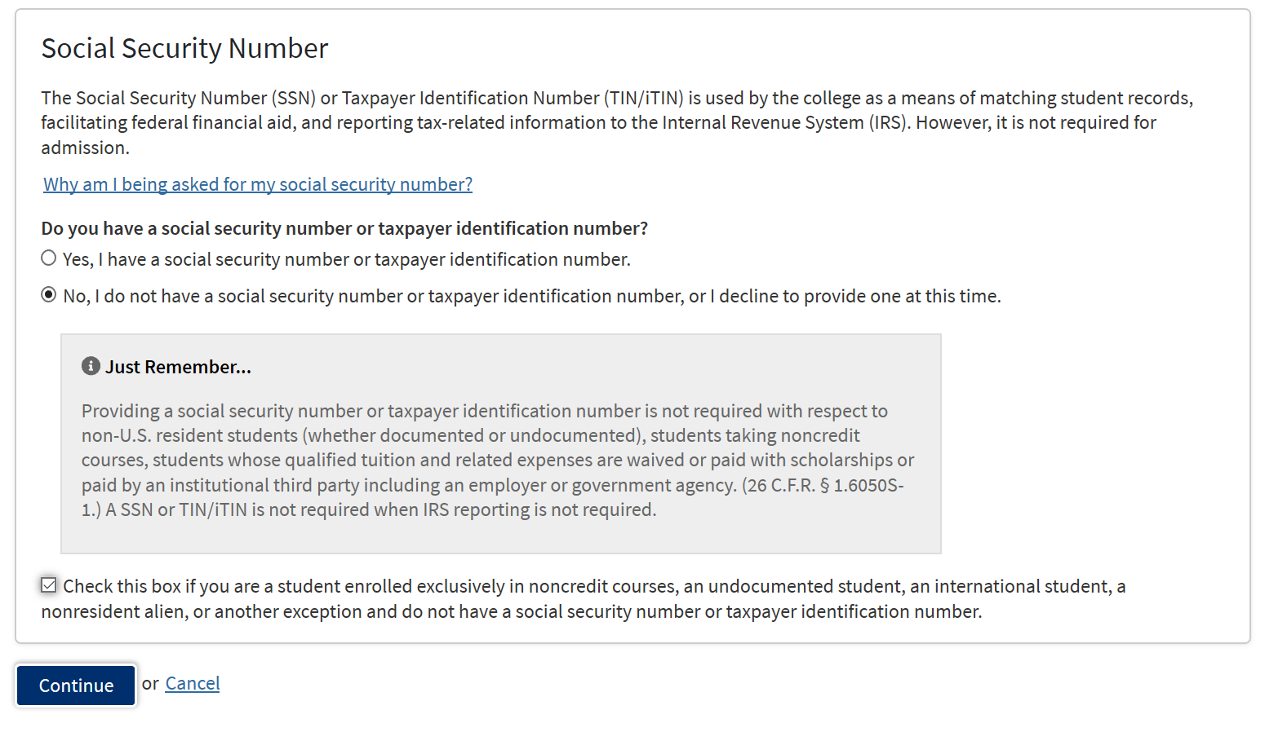
For the sole purpose of taking non-credit courses, you do not need to share your social security number, therefore we highly advice to select “No, I do have a social security number…..”
However, if you will like to share it you can by selecting “Yes, I have a social security number…..”
You don’t need a social security number, unless you plan to
apply for Financial aid and you can update that information later
in our Financial aid office.
When you select No, check the box in the bottom if you are undocumented,
international or a non-resident student and then click on Continue.

Slide 7
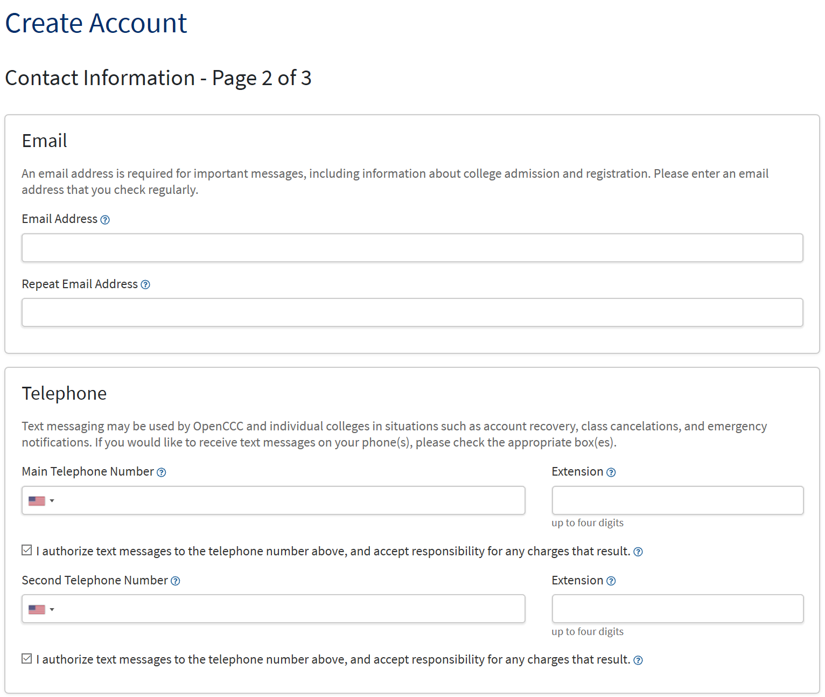
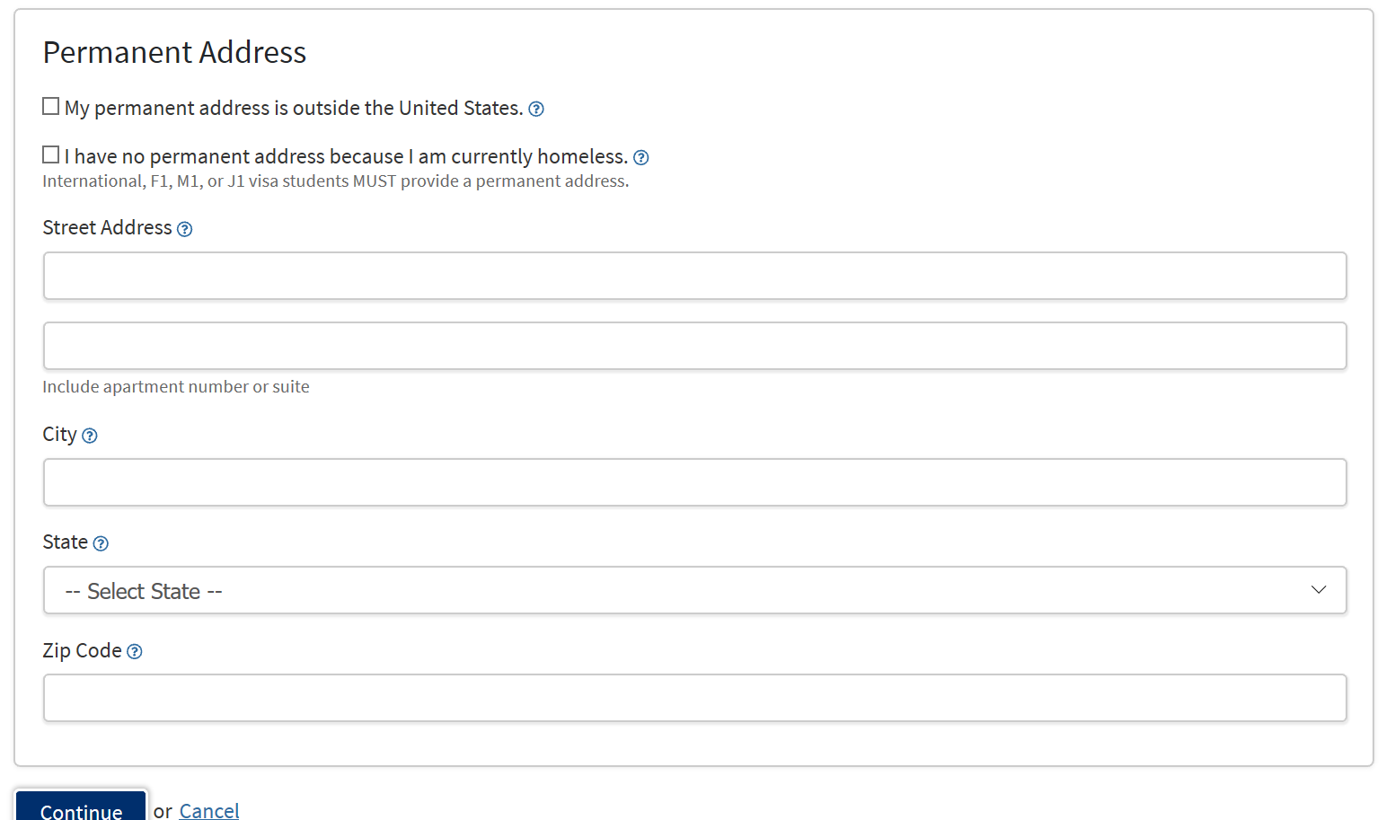
Enter your email address twice, at least one
phone number and you permanent home
address and once completed click
on CONTINUE

Slide 8
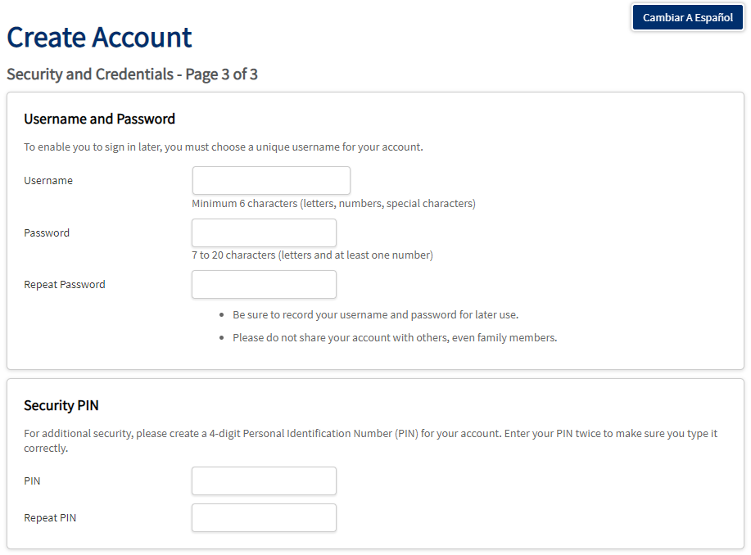
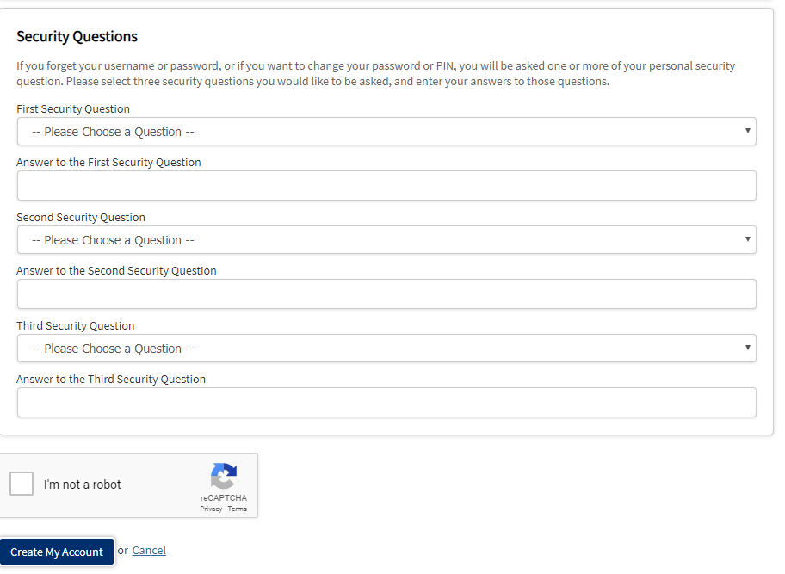
Create a username and password, also a 4-digit pin and select security questions and answers. Make sure you save this information for future use, since you will need it if you ever decide to apply to another CA community college in the future.
After completing the information click on “Create My Account”

Slide 9
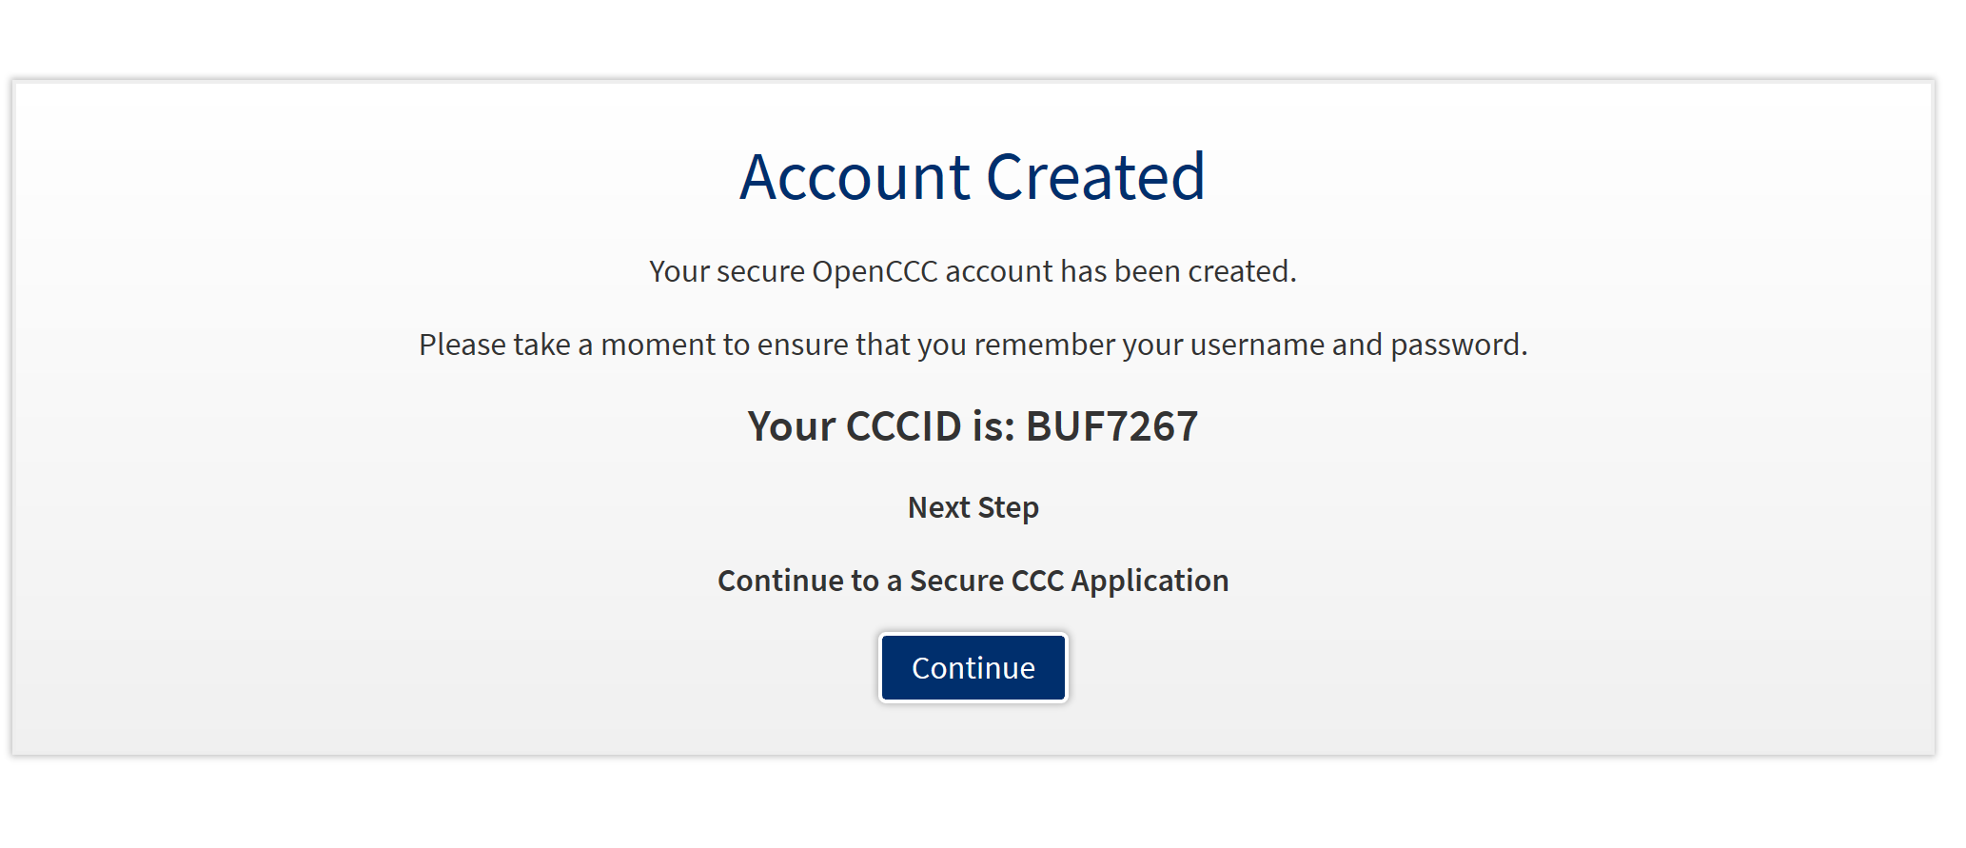
Once you complete your account you will get a notice like this and also an email confirming the creation of your CCAPPLY acct. Please click on the CONTINUE button to proceed to the official WLAC non-credit application.
Click on START NEW APPLICATION

Slide 10
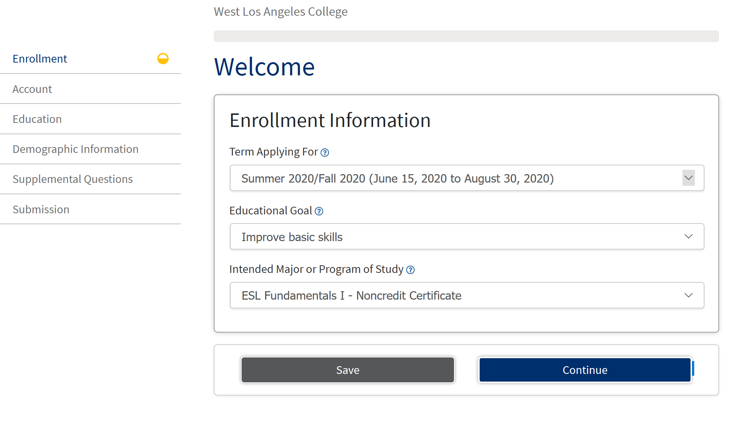
Enrollment Information
Always select the most current semester and for the educational goal select “to improve basic skills” if you are unsure what to select.
To the best of your knowledge, select the program or courses you are currently interested in taking

Slide 11
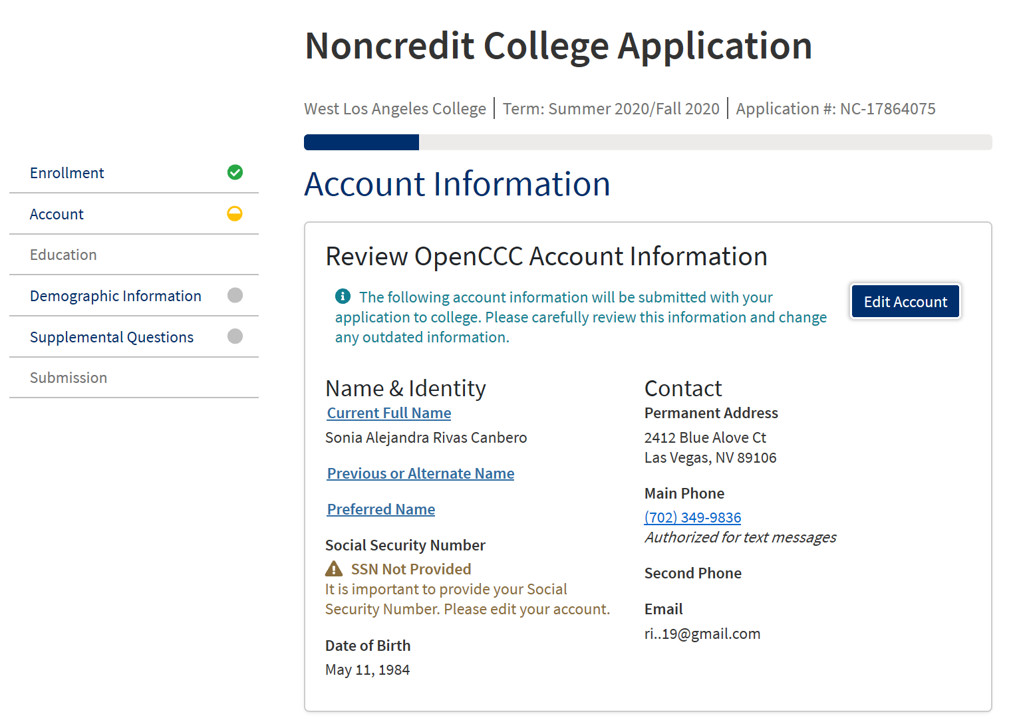
Account & Mailing Information
Verify your personal information you inputed in your CCAPPLY account, if you will like to edit it, click on the EDIT ACCOUNT button. This is the same information that will be reflected on your official college account.

Slide 12
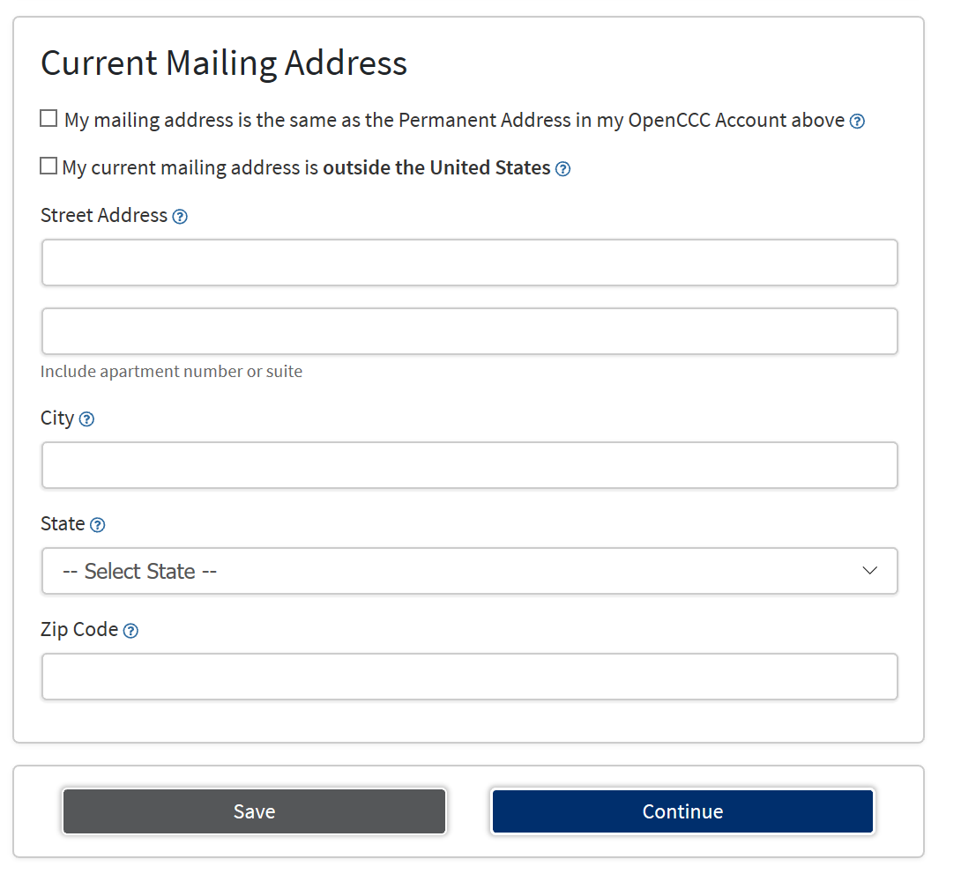
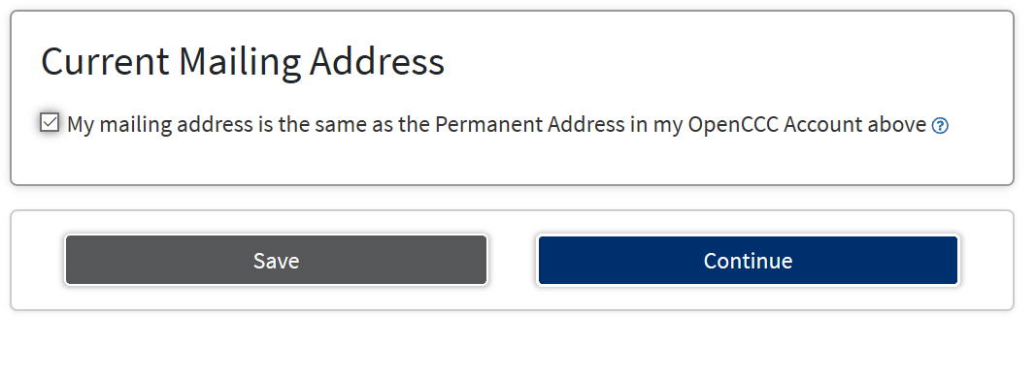
If your mailing address is the same as the one you inputed in your CCAPPLY account, select this button. If not proceed with inputing the address you will like to show on your college account.
When you select this option, the page will change like this and then you click on CONTINUE

Slide 13
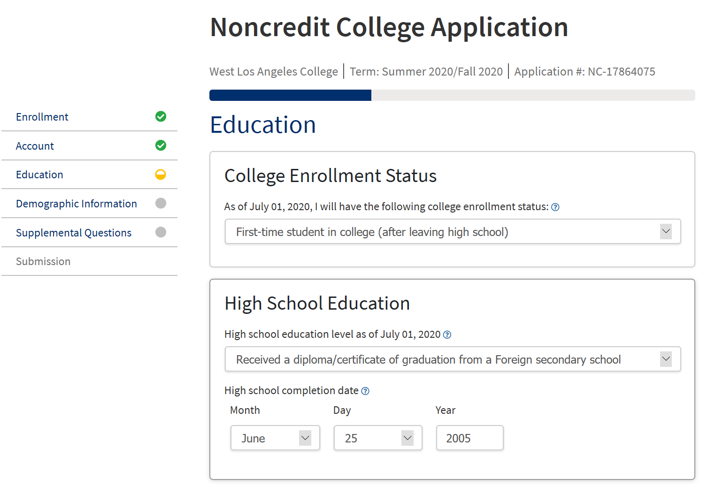
Select your college enrollment status and your High School education level.
NOTE- If you did not attend HS or graduated from a foreign country select- “Received a diploma/certificate of graduation from a Foreign secondary school”
- Most graduation dates fall on June 25th

Slide 14
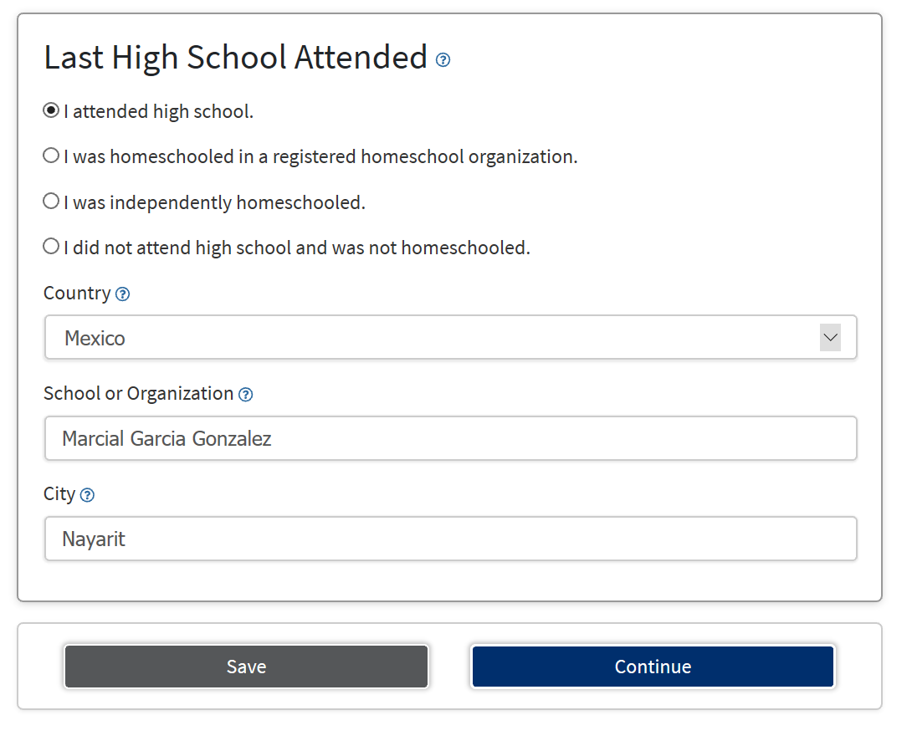
When you select that you gruaduated or attended High school the following screen will show.
If you graduated from a HS in CA or US make sure you enter the school name and city.
-If you never attended HS or graduated from a foreign country select “I attended high school” and put the last school you attended. It does not matter if it was not a High school, the system wants to know a school name to proceed.
After you are done click on CONTINUE

Slide 15
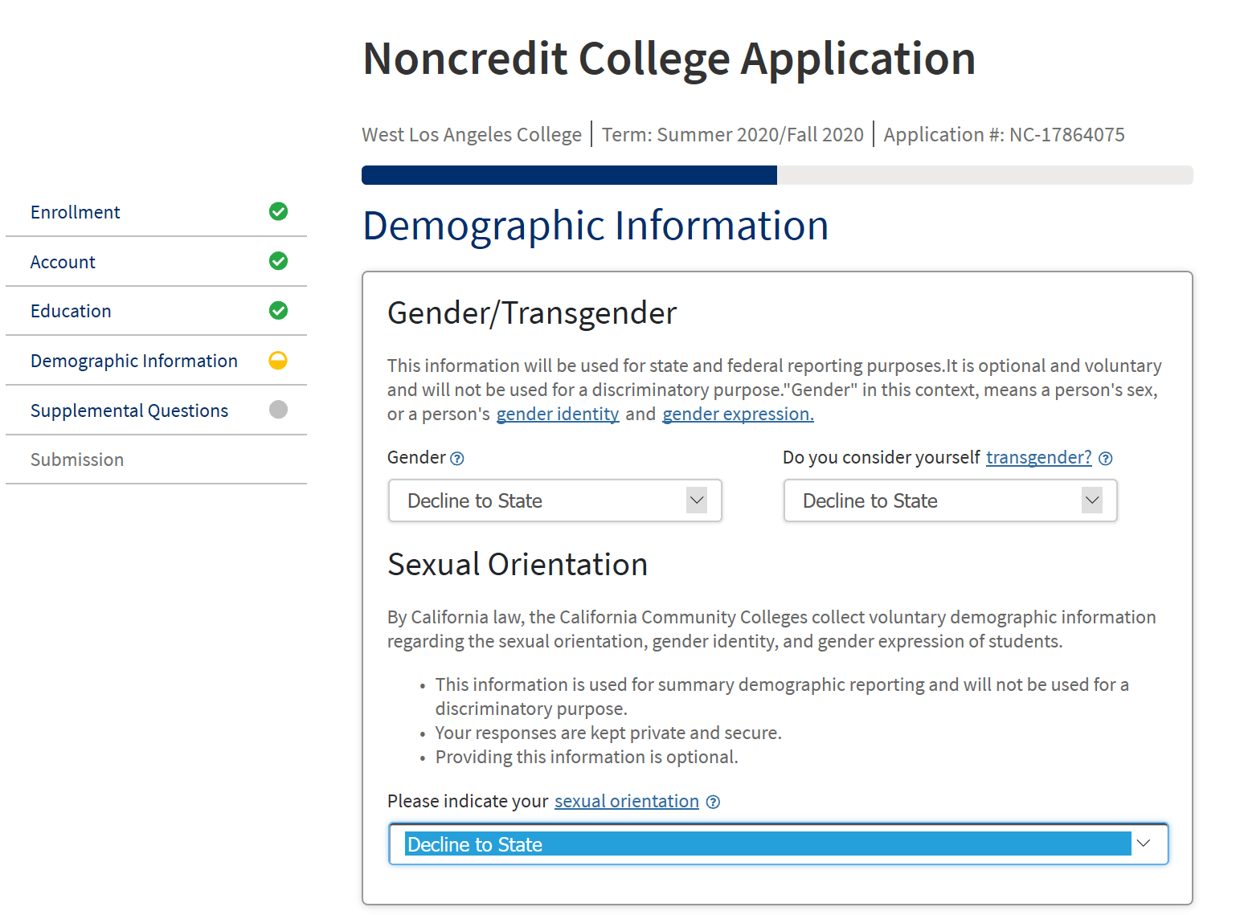
Demographic Information is taken for statistical purposes and data analysis on our student population.
Therefore it is at your discretion if you will like to answer these questions or select to “Decline to State”

Slide 16
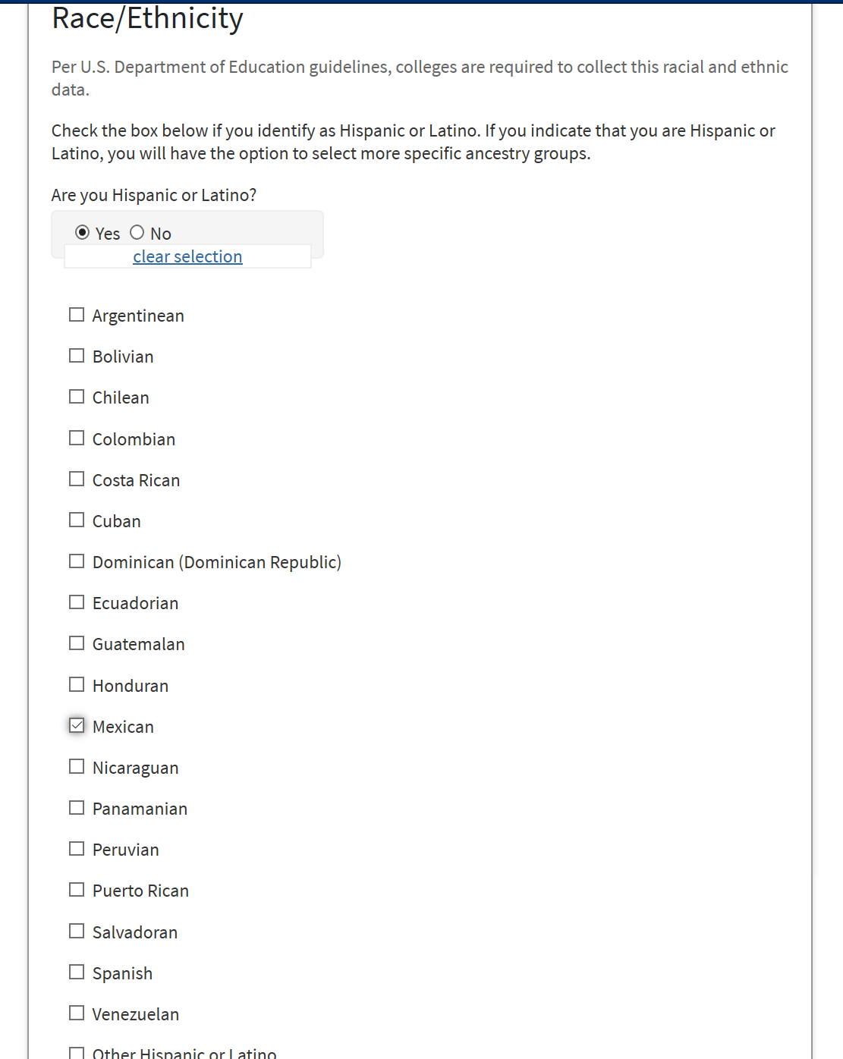
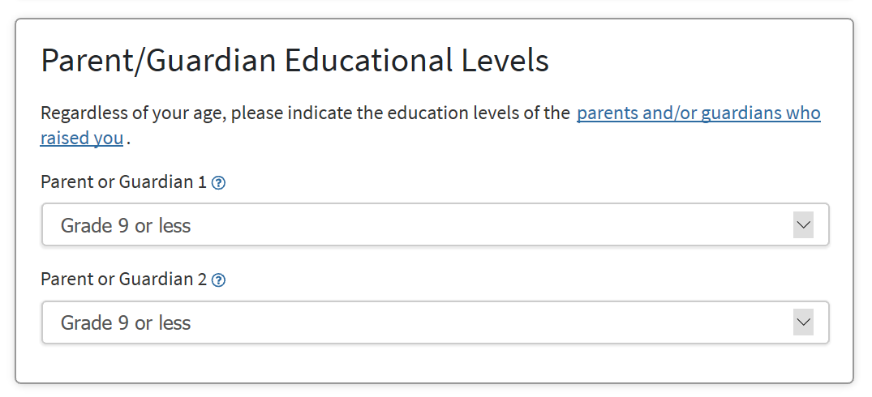
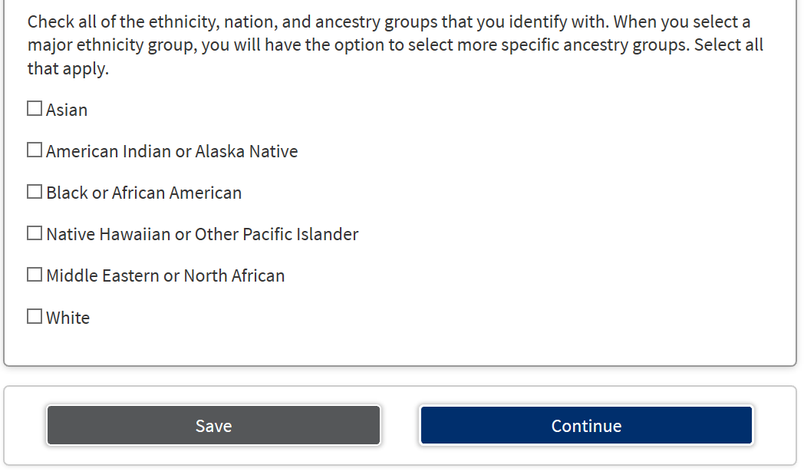
Select your parents highest educational level, if you do not know you can also select that option.
When complete, select Continue
Select your ethnic/race- when you select you are Hispanic the long list of nationalities come out- select one or more

Slide 17
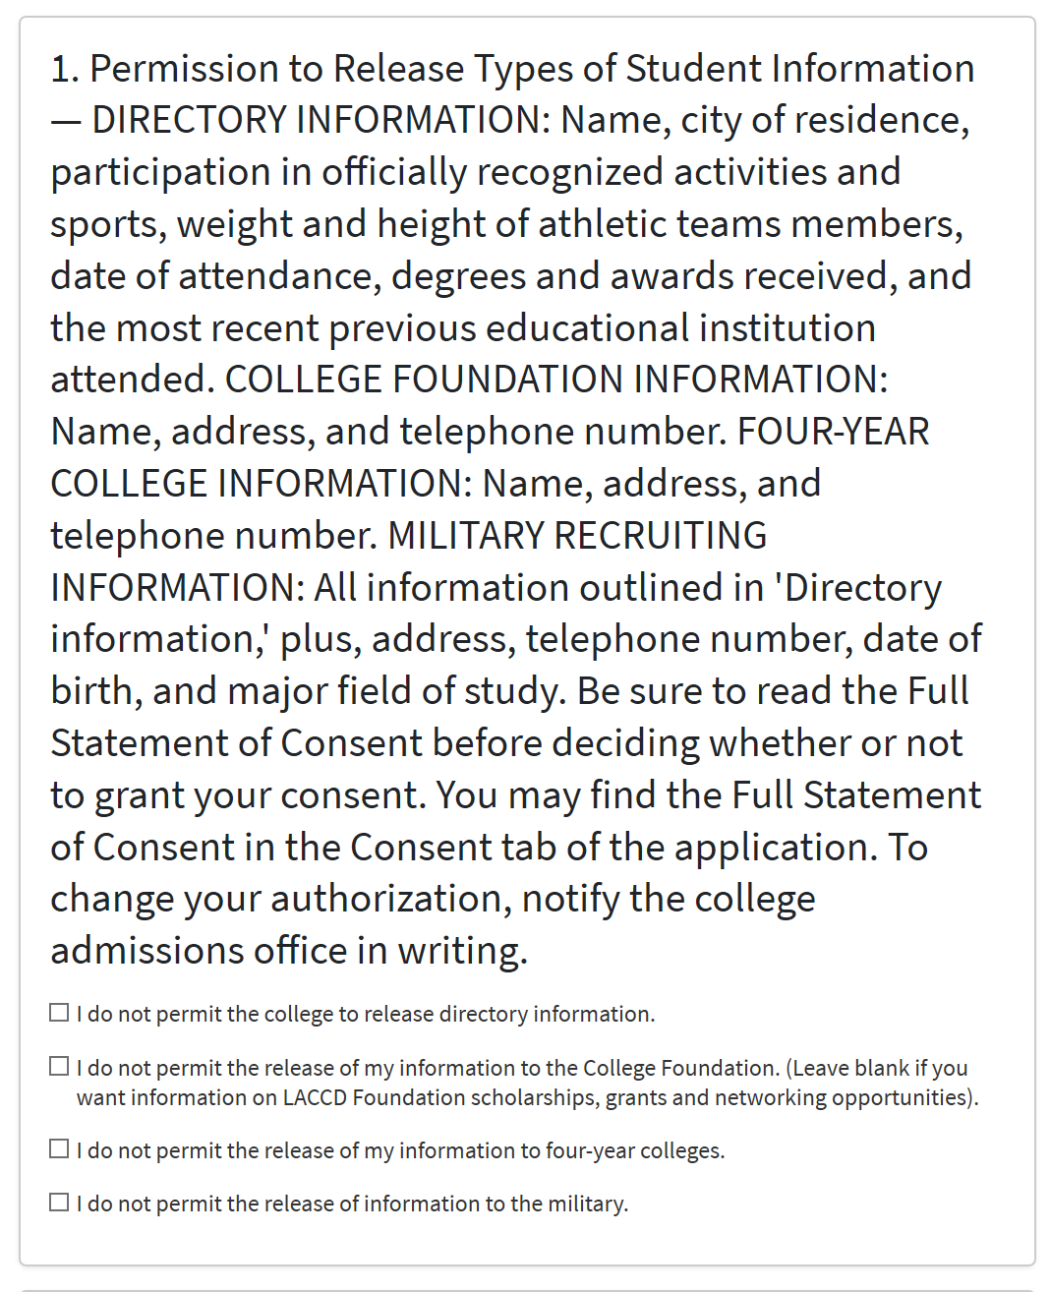
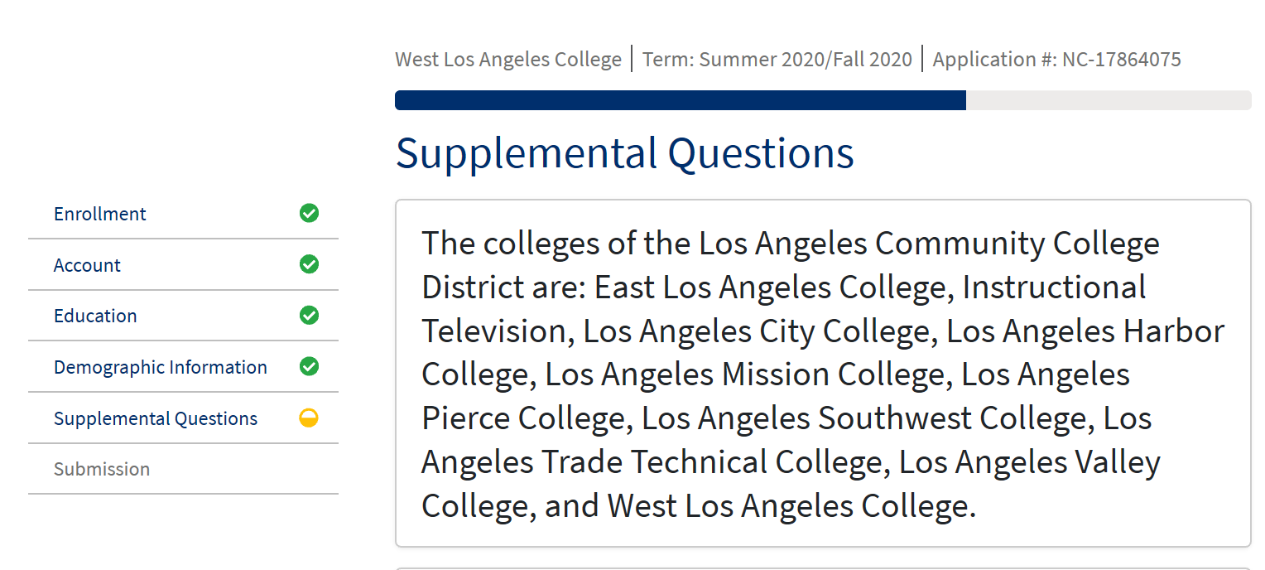
Supplemental Questions
-WLAC is part of the LA Community College district that consist of 8 other colleges across the LA county. The following statement is letting you know if you agree with the district releasing some of your student information like name, city of residence, etc. It is based on entity, and you can select which ones you permit or do not permit to release some of your information to

Slide 18
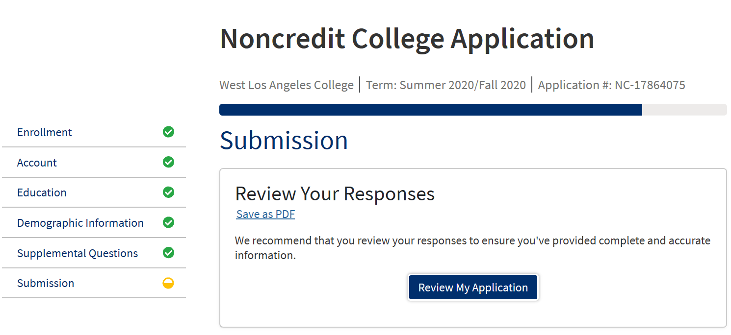
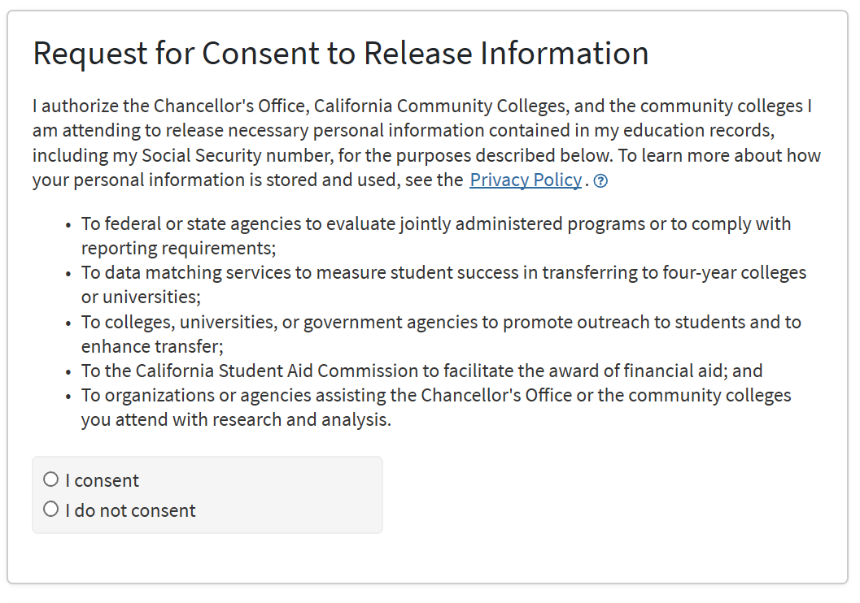
Review Application
- Review your Application for accuracy in regards to your name, address and DOB. If you feel confident you entered the correct information then proceed to the next question.
Read the statement above and make sure to select “I consent” or “ I do not consent”

Slide 19
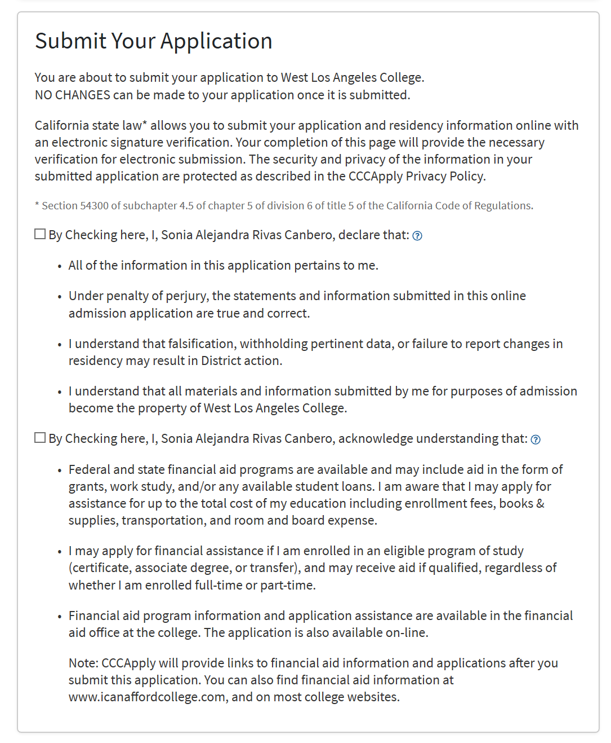
Submit your application
Read the statements and make sure you agree and check off the“consent” boxes.
Then click on “submit my application”.

Slide 20
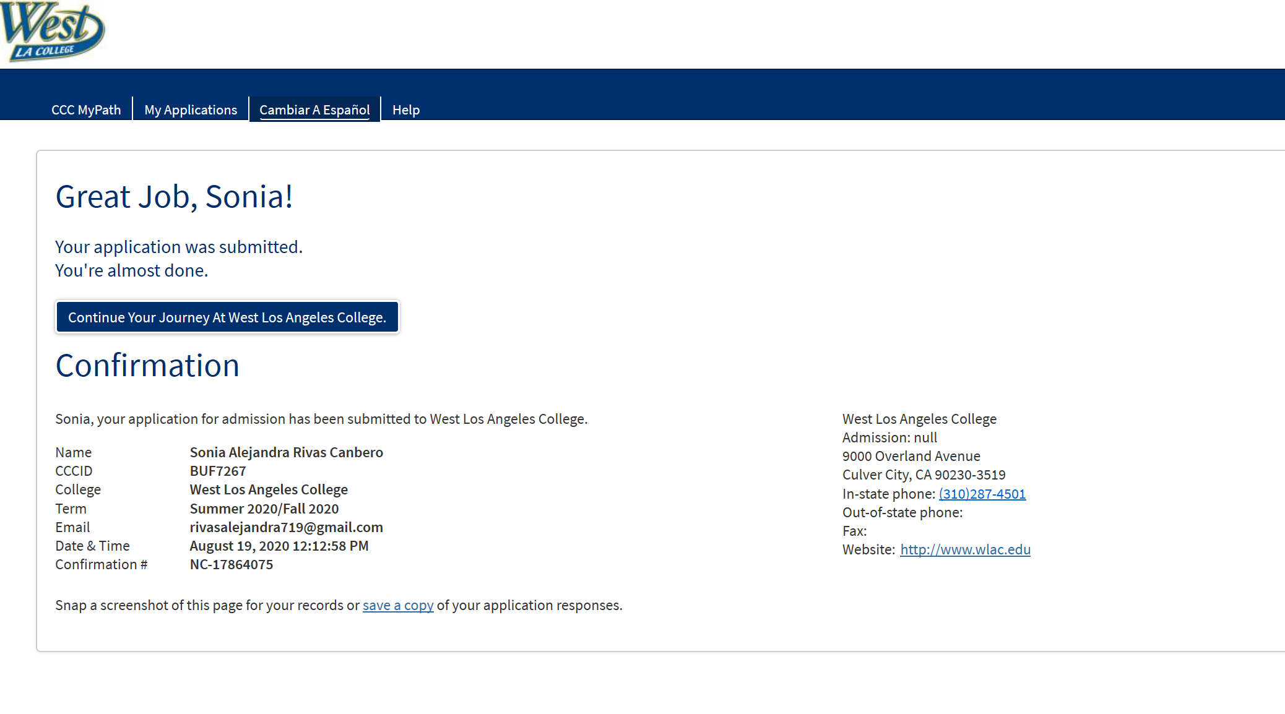
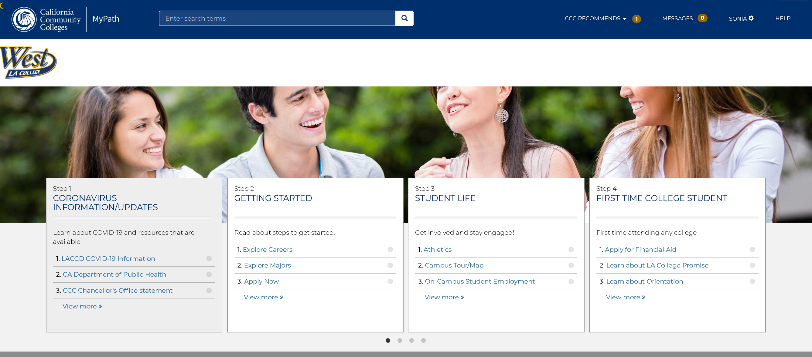
Once your application has been submitted your screen will show you this confirmation (an email will also be sent containing the same information). Within 3 to 5 business days you will receive another email containing your WLAC student ID number that will start with 90 or 88. Make sure to check your inbox or spam folder.
In the meanwhile if you will like to read more information about our campus programs, careers and current Covid-19 updates, click on “Continue Your Journey..” (Blue button) and it will direct you to My Path (see left pic for reference) where additional information is available to you.

Slide 21
I just submitted my application to West, what do I do next?
As previously notified, within 3 to 5 business days your application will be processed.
You will receive an email with your student ID. (it will start with 90 or 88) Please check your inbox and Spam folder.
Then you will be able to log into your WLAC student portal to enroll in courses.
If you need assistance enrolling you may call the Learning Center for assistance at (310)287-4404 M-F within 9am and 5:15pm. You may also email Maritza Medina at medinam@wlac.edu for further assistance.
Congratulations in completing the first step in
becoming a West LA college student!

